Slide 1
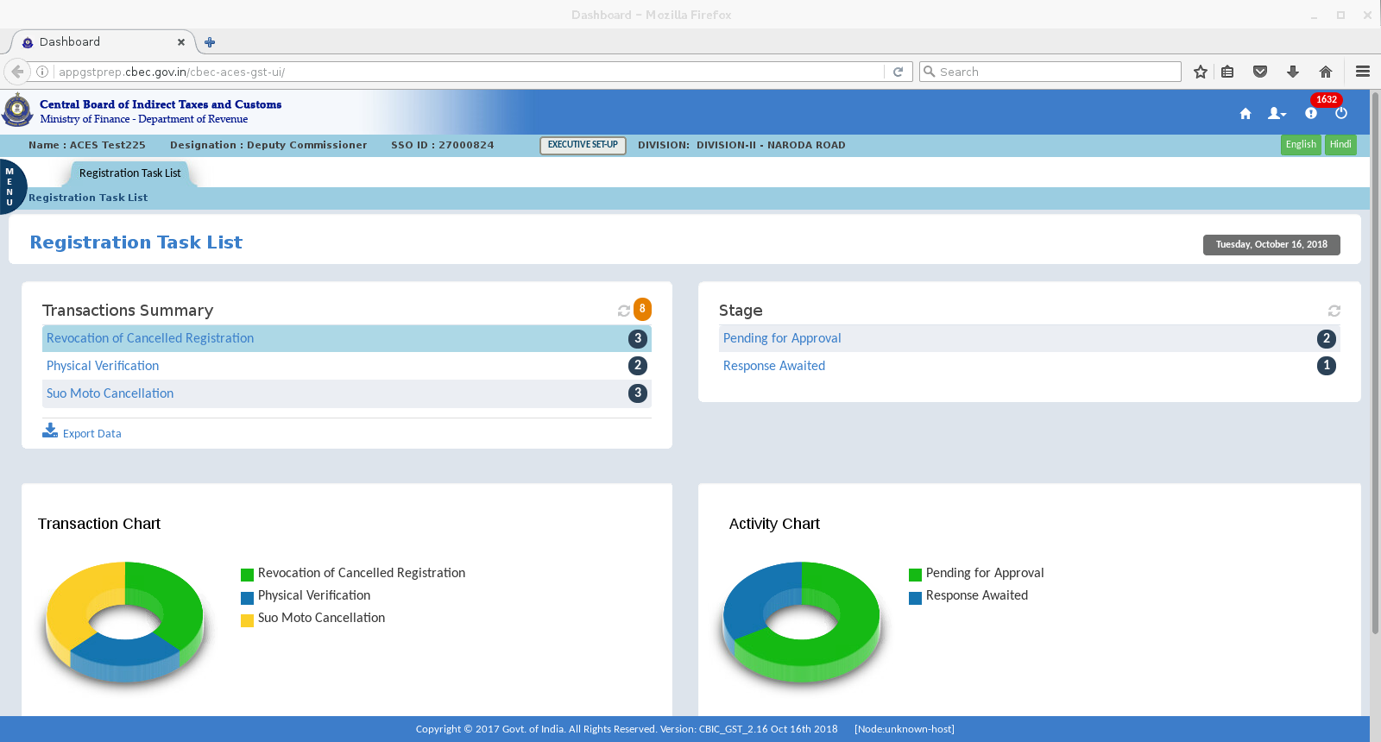
Dashboard of the AC/DC (proper officer) –Revocation of application comes for approval

Slide 2
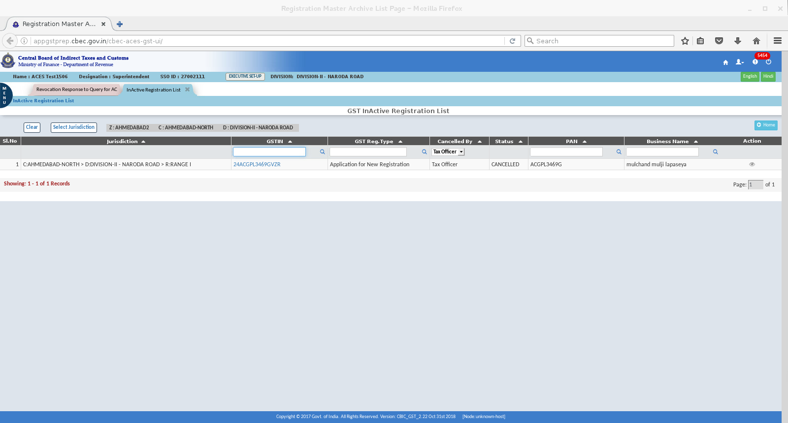
APPLICATIONS WHICH HAS COME FOR REVOCATION CAN BE VERIFED WHETHER THEY ARE IN INACTIVE LIST. ( MENU-REGISTRATION-INACTIVE LIST )

Slide 3
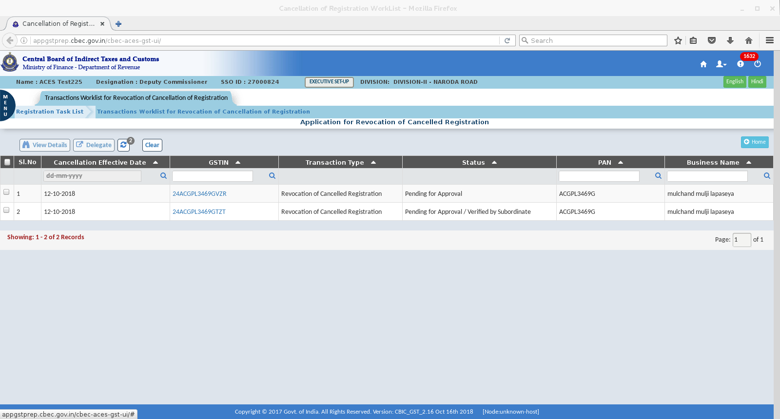
Worklist showing pending for approval

Slide 4
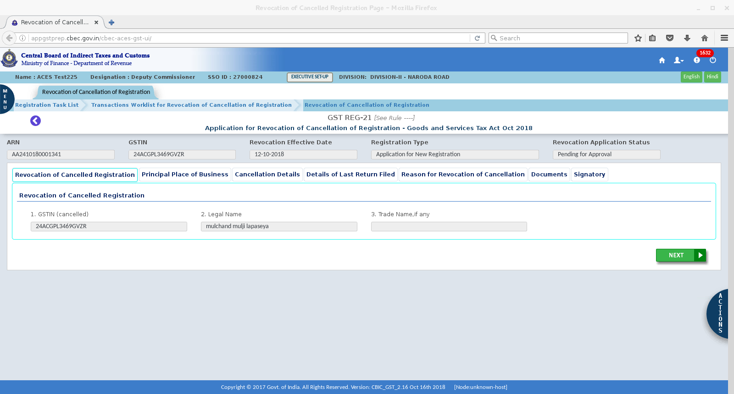
APPLICATION CAN BE VIEW BY CLICKING ON THE GSTIN HYPERLINK

Slide 5
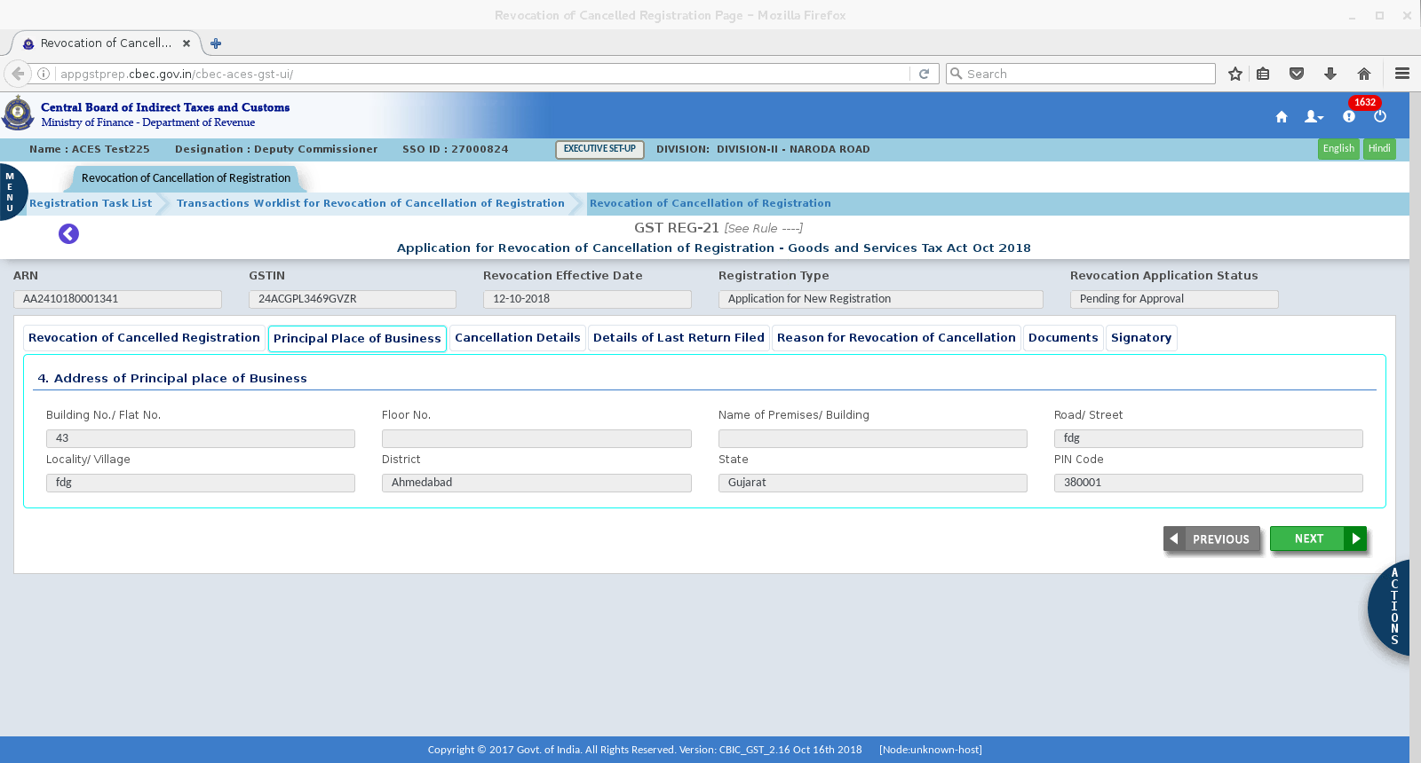

Slide 6
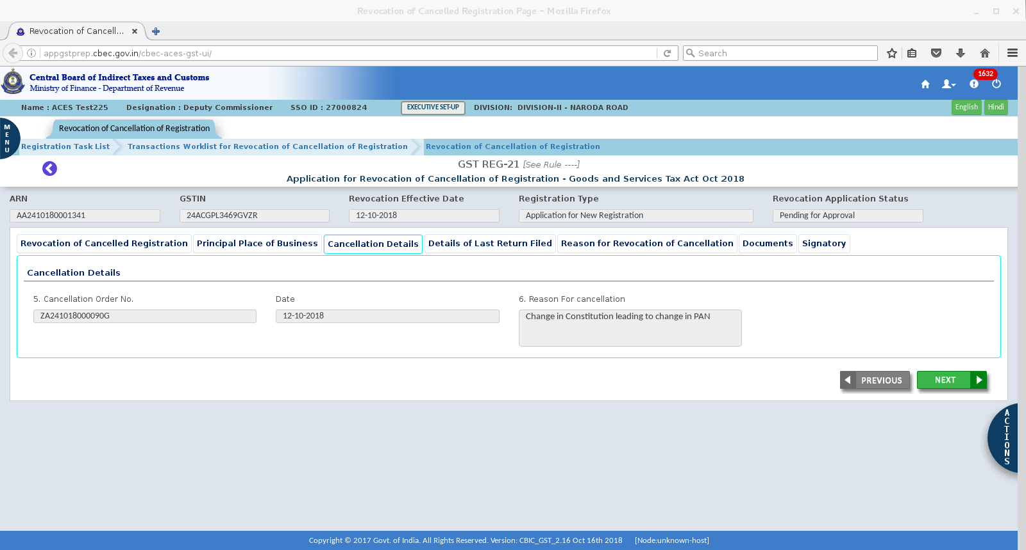

Slide 7
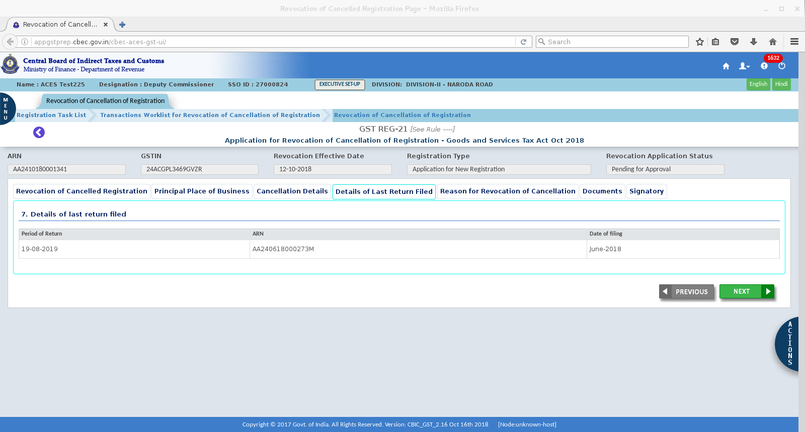

Slide 8
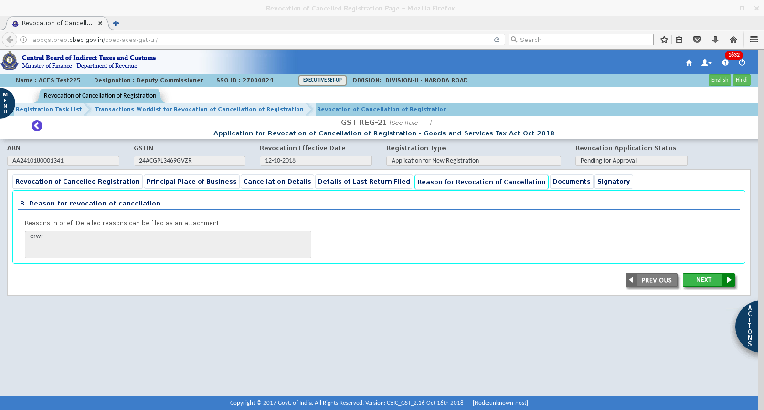

Slide 9
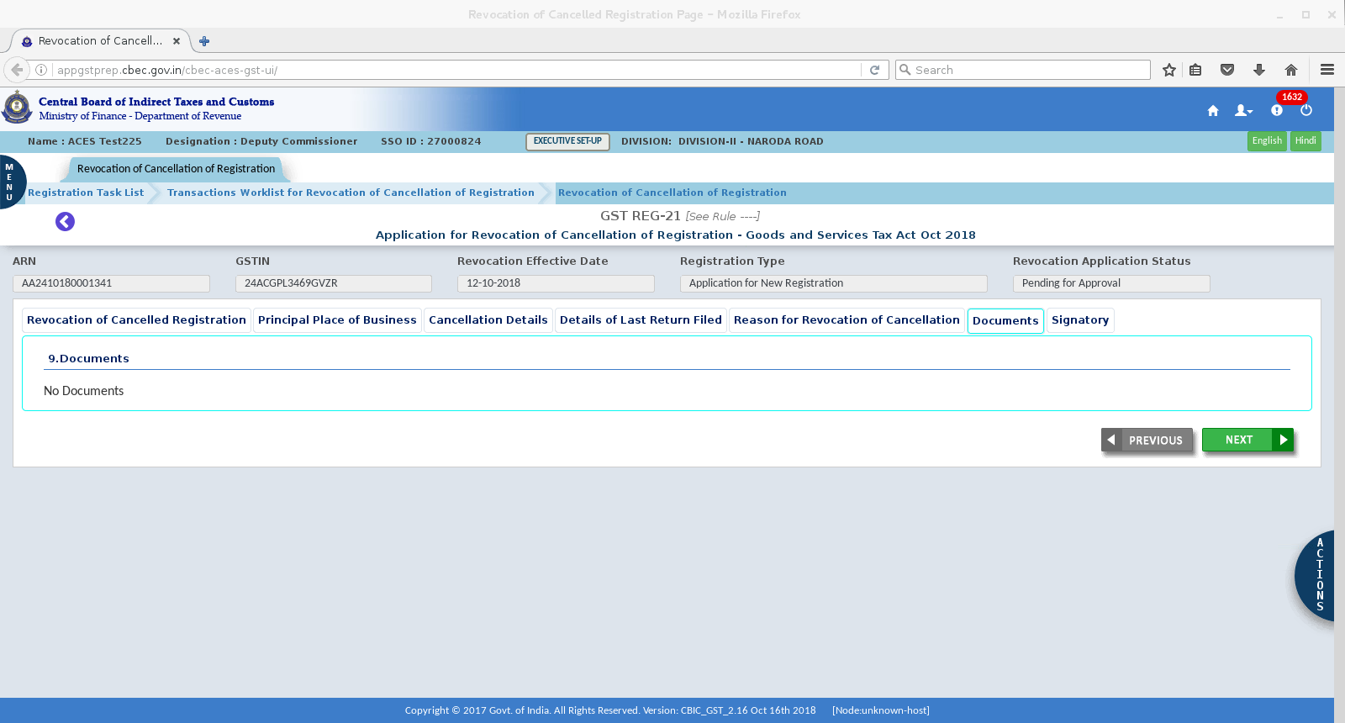

Slide 10
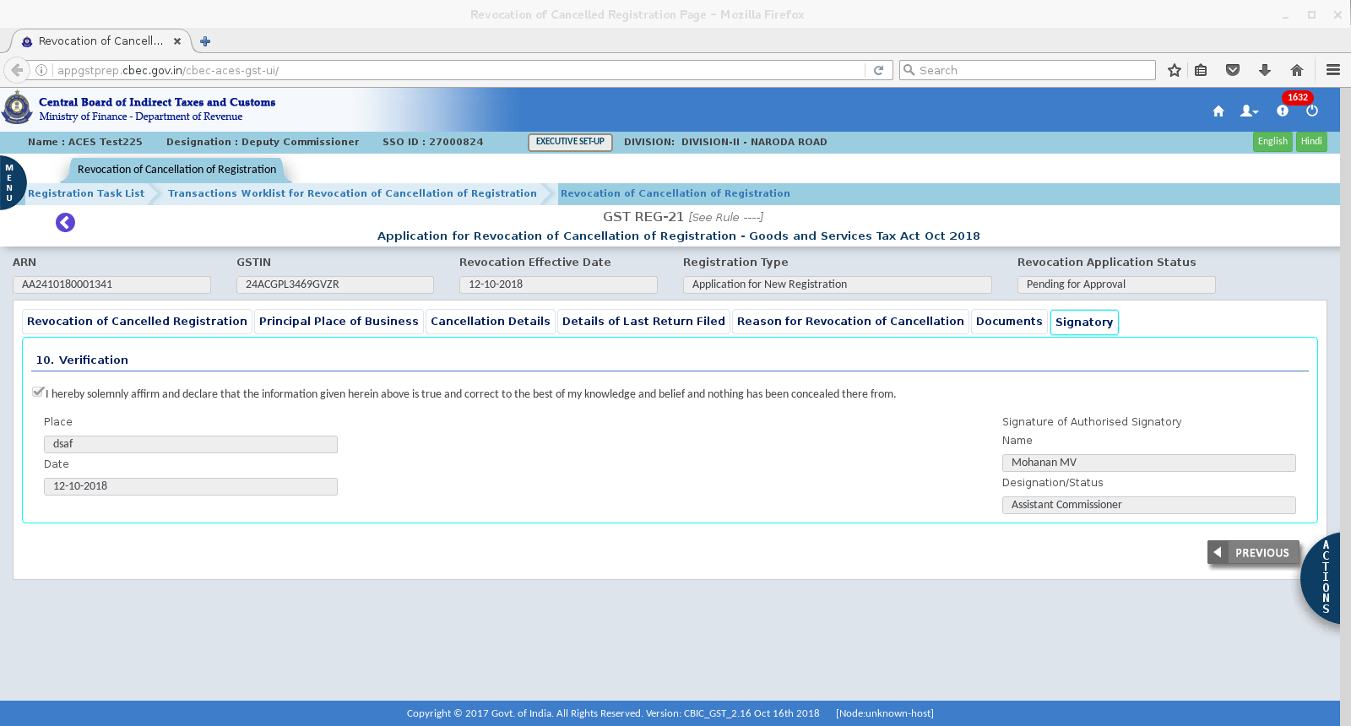

Slide 11
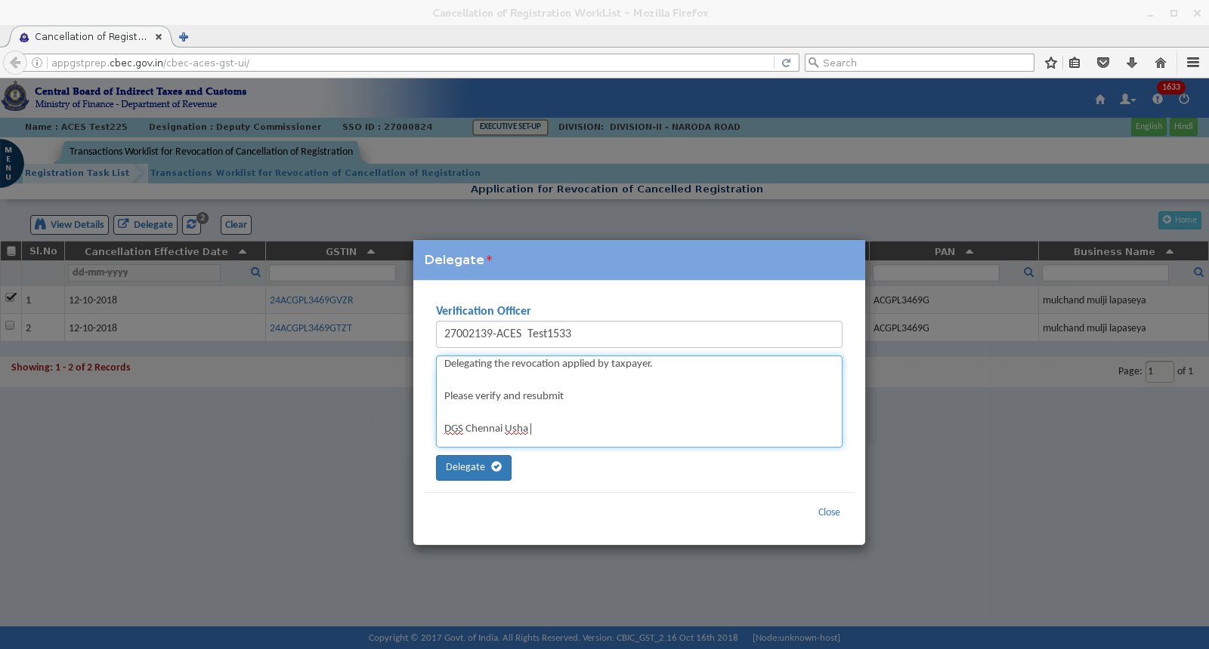
DELEGATE SCREEN- Delegating to Supdt /Inspr- Check box shown on left hand corner to be selected and click on delegate .

Slide 12
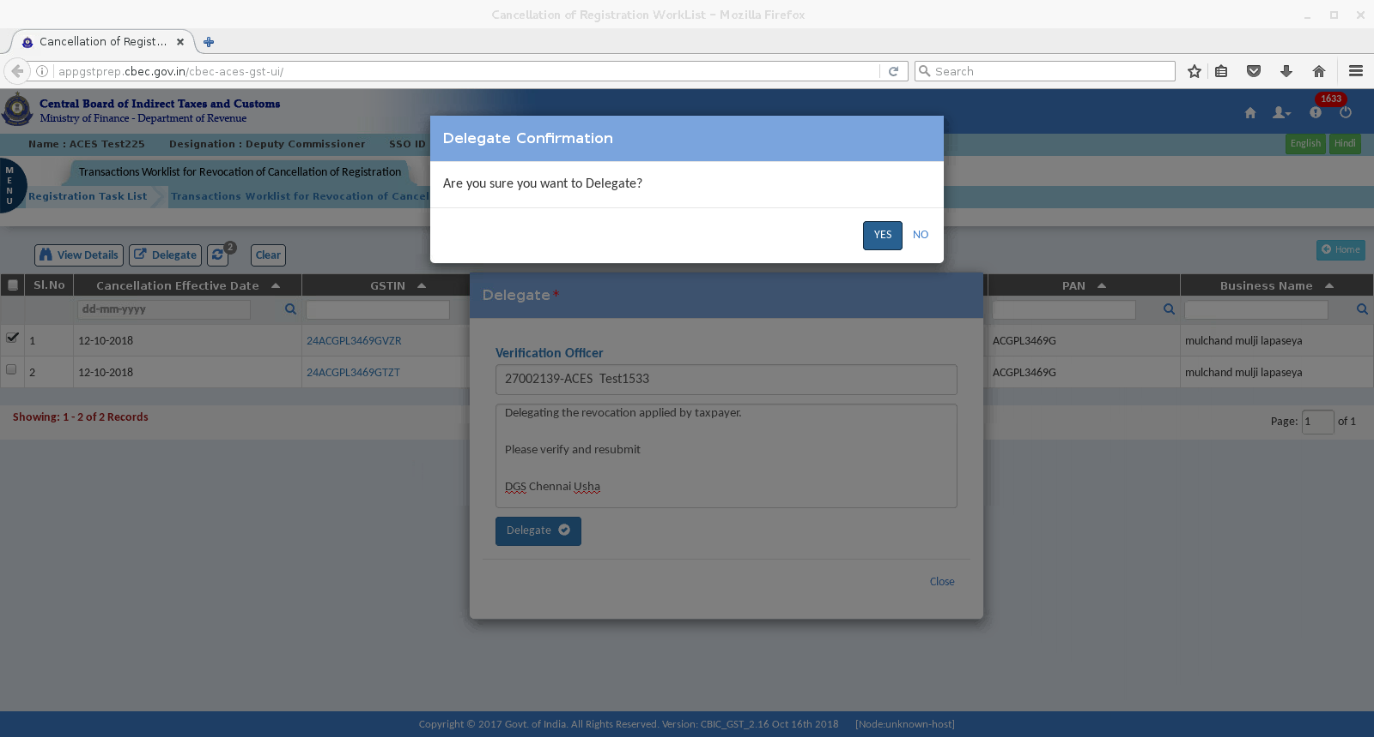
Delegation Confirmation screen

Slide 13
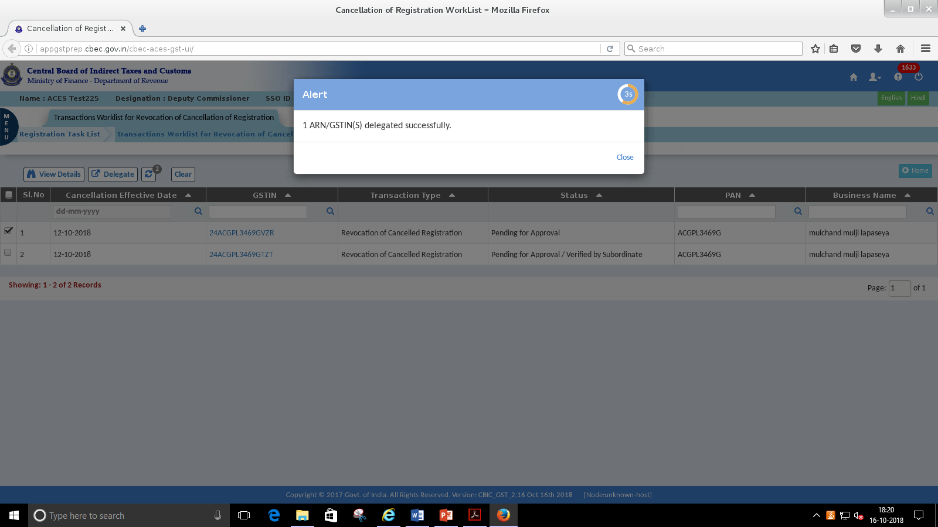

Slide 14
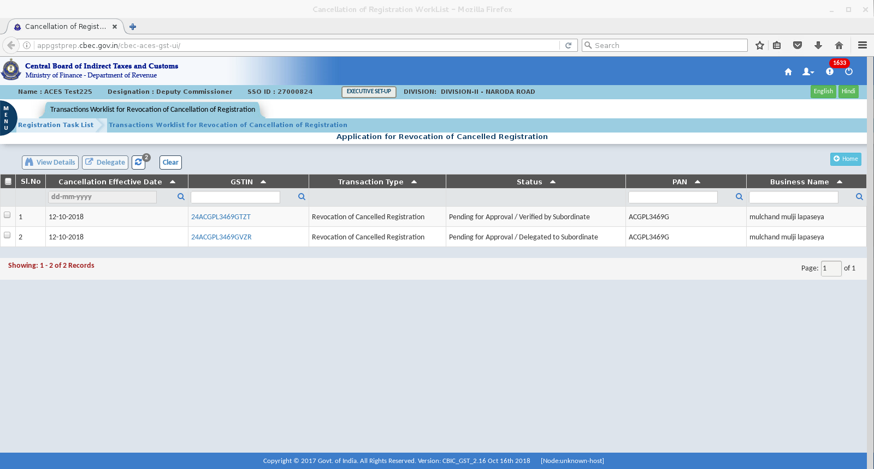
DC/AC - worklist shows Delegated to subordinate

Slide 15
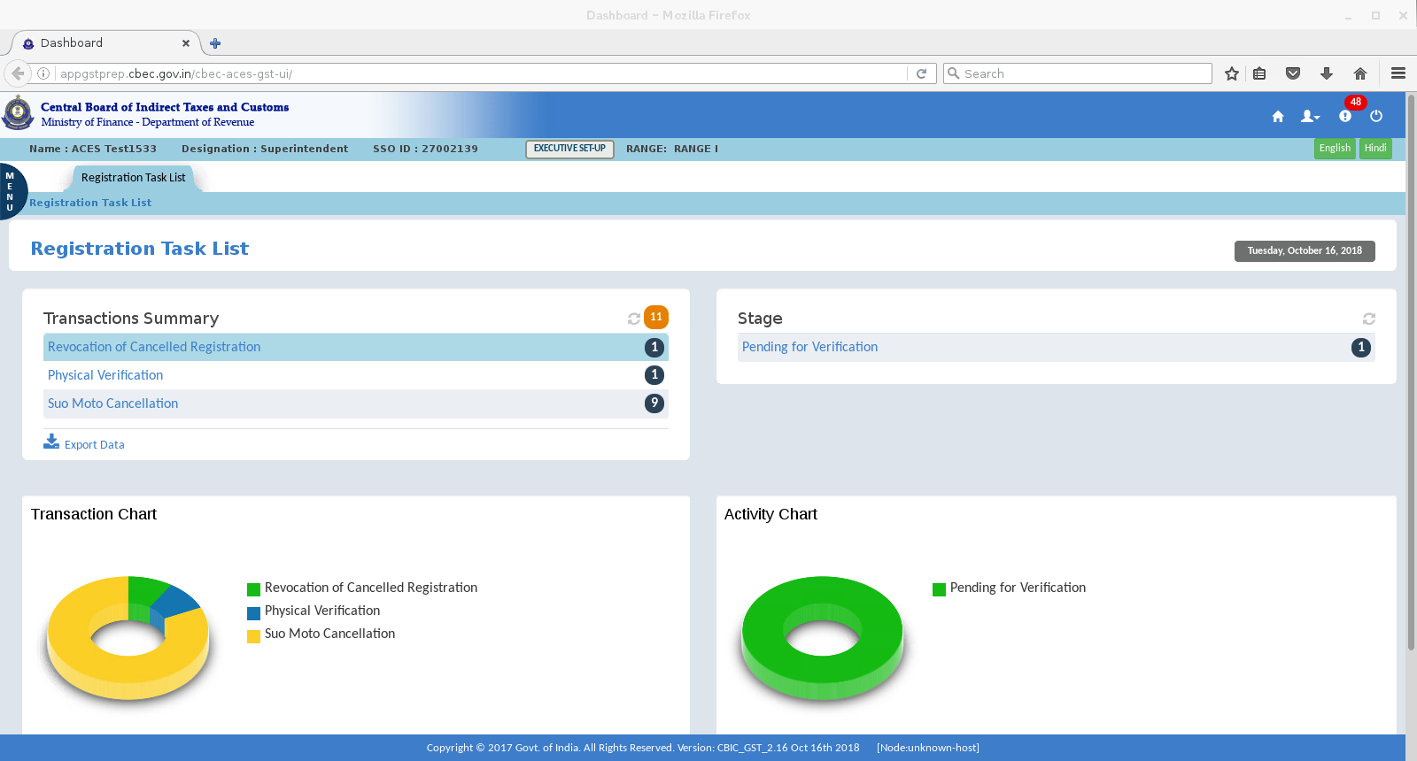
SUPDT DASHBOARD-SHOWING PENDING VERIFICATION

Slide 16
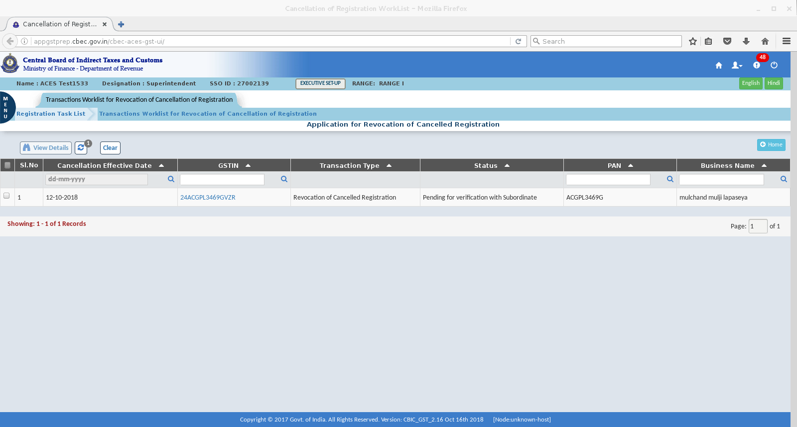
Worklist showing pending for approval.
Click on GSTIN to view the instructions from DC/AC

Slide 17
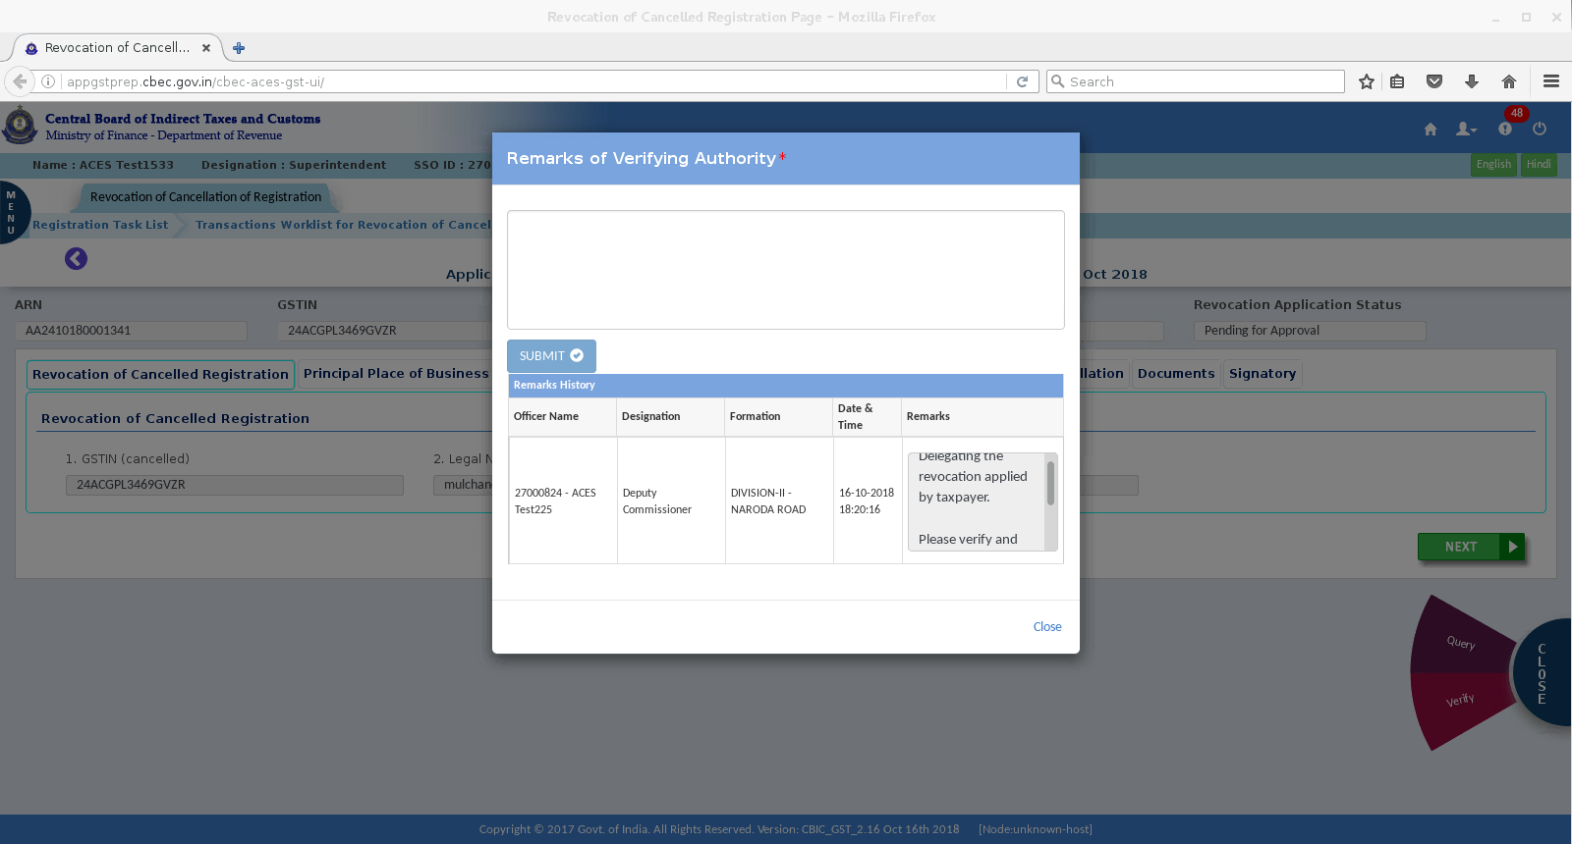
FROM ACTION BUTTON ON CLICK OF VERIFY – SUPDT WILL BE SEEING THE VERIFICATION REMARKS FROM AC/DC. SUPDT CAN ENTER THE VERIFICATION REMARKS AND SUBMIT

Slide 18
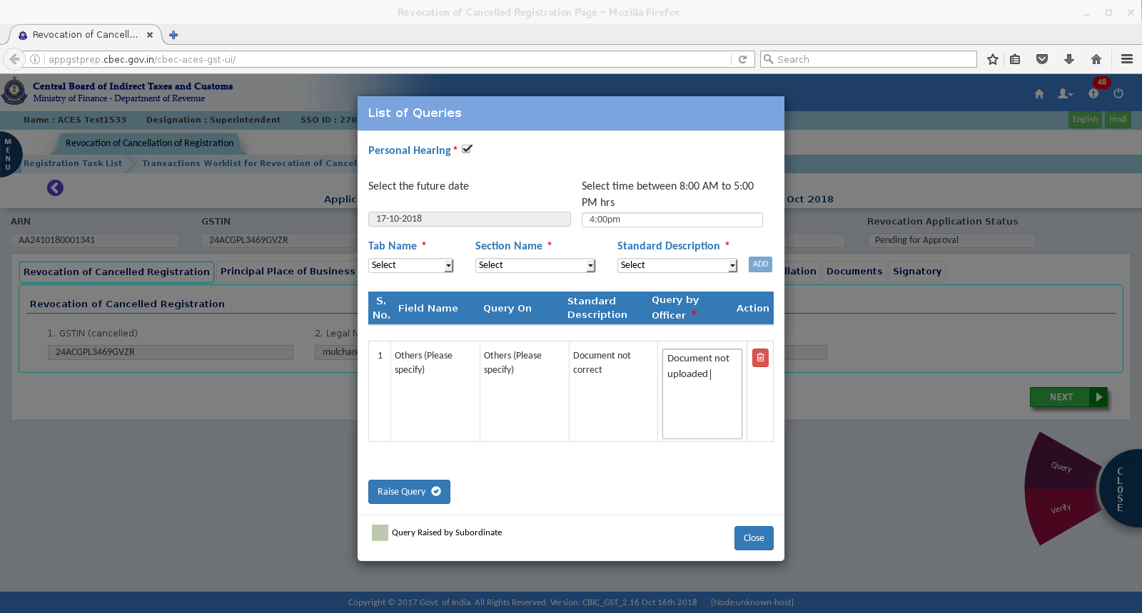
ON CLICK OF QUERY AT THE ACTION BUTTON –BELOW POP UP BOX APPEARS WHEREIN SUPDT CAN ENTER HIS OBSERVATIONS ALONG WITH PH DATE AND TIME WHICH ARE MANDATORY FIELDS AND SUBMIT TO DC/AC.

Slide 19
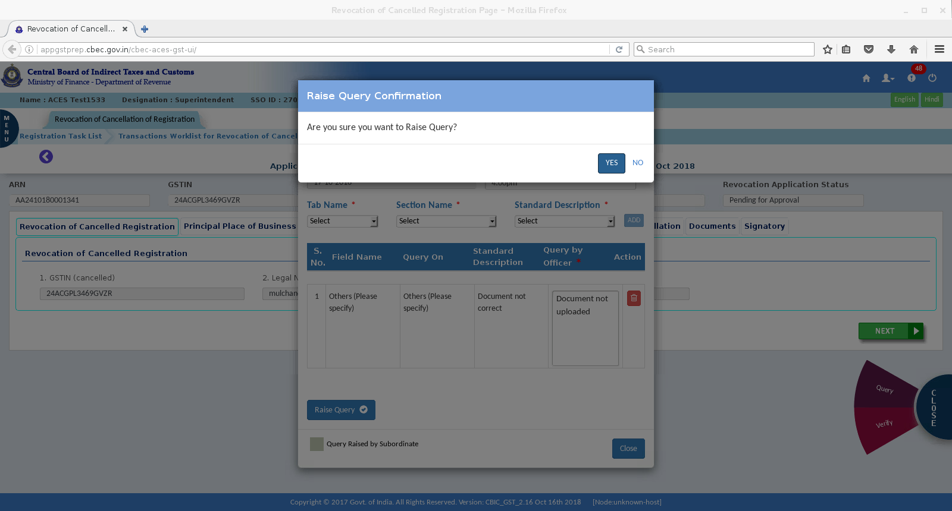
CONFIRMTION SCREEN – FOR RAISING QUERY

Slide 20
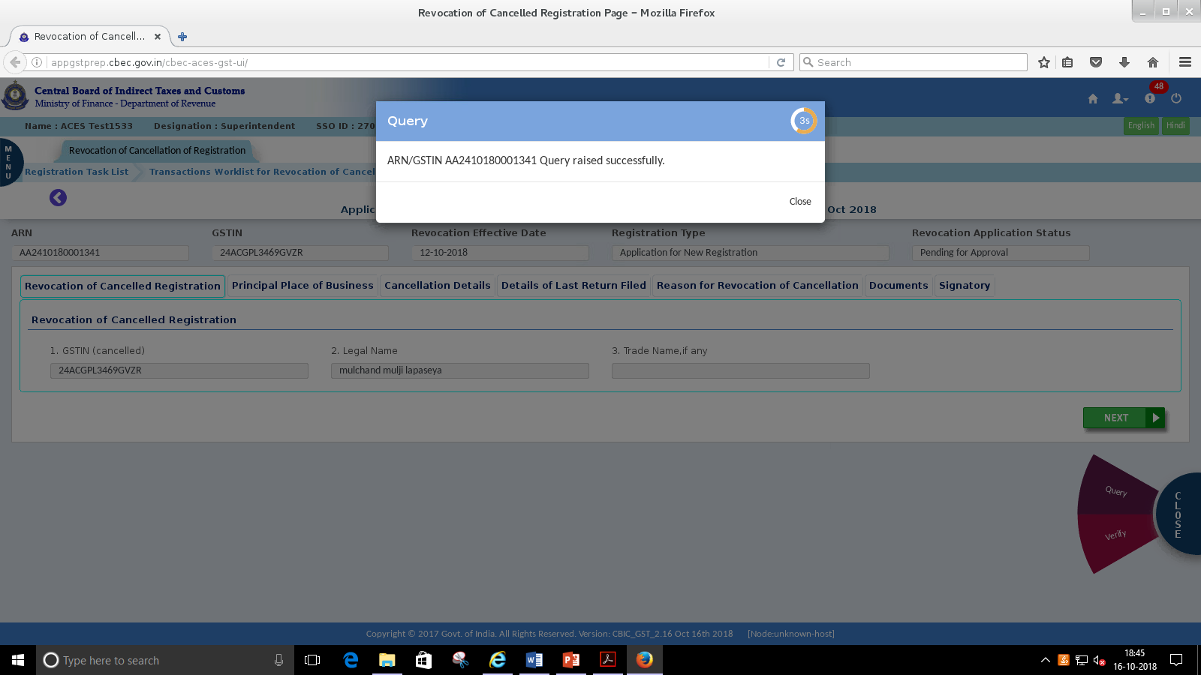

Slide 21
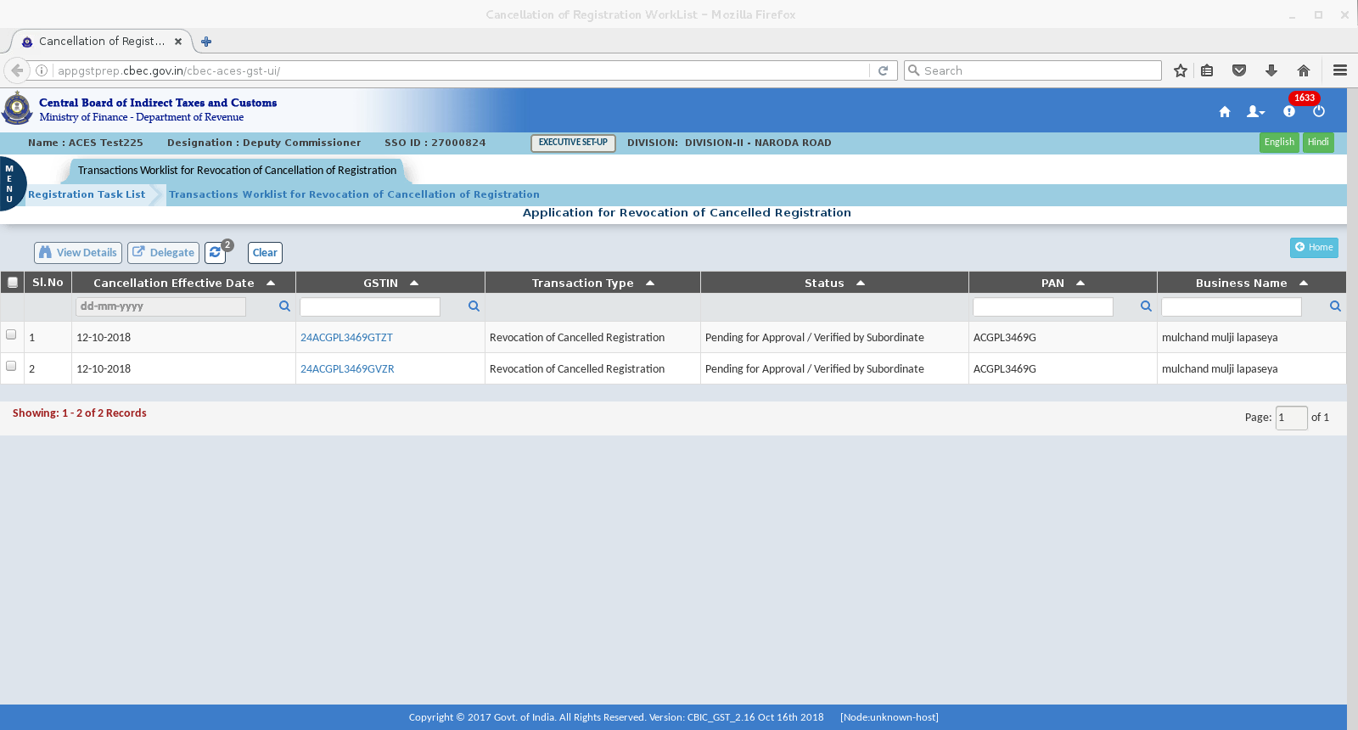
AC/DC DASHBOARD SHOWS –VERIFICATION REPORT SUBMITTED BY SUPDT

Slide 22
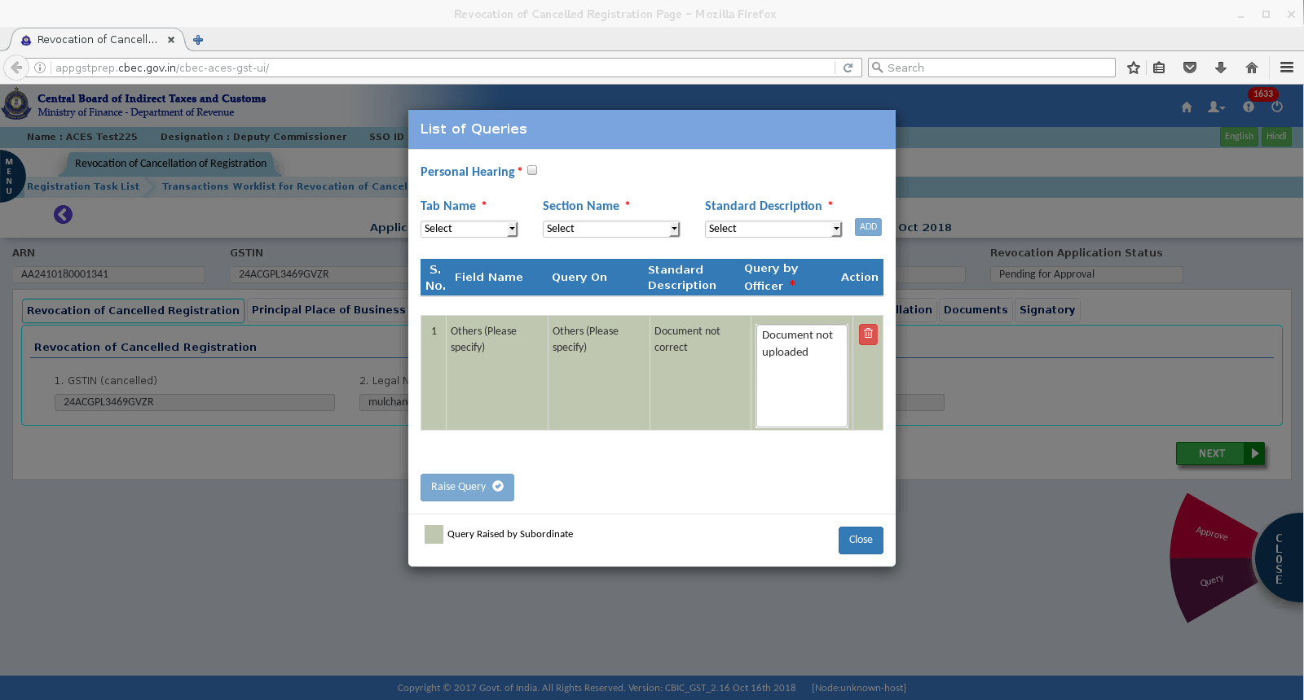
ON CLICK OF QUERY FROM ACTION BUTTON QUERY RAISED BY RSP IS SHOWN

Slide 23
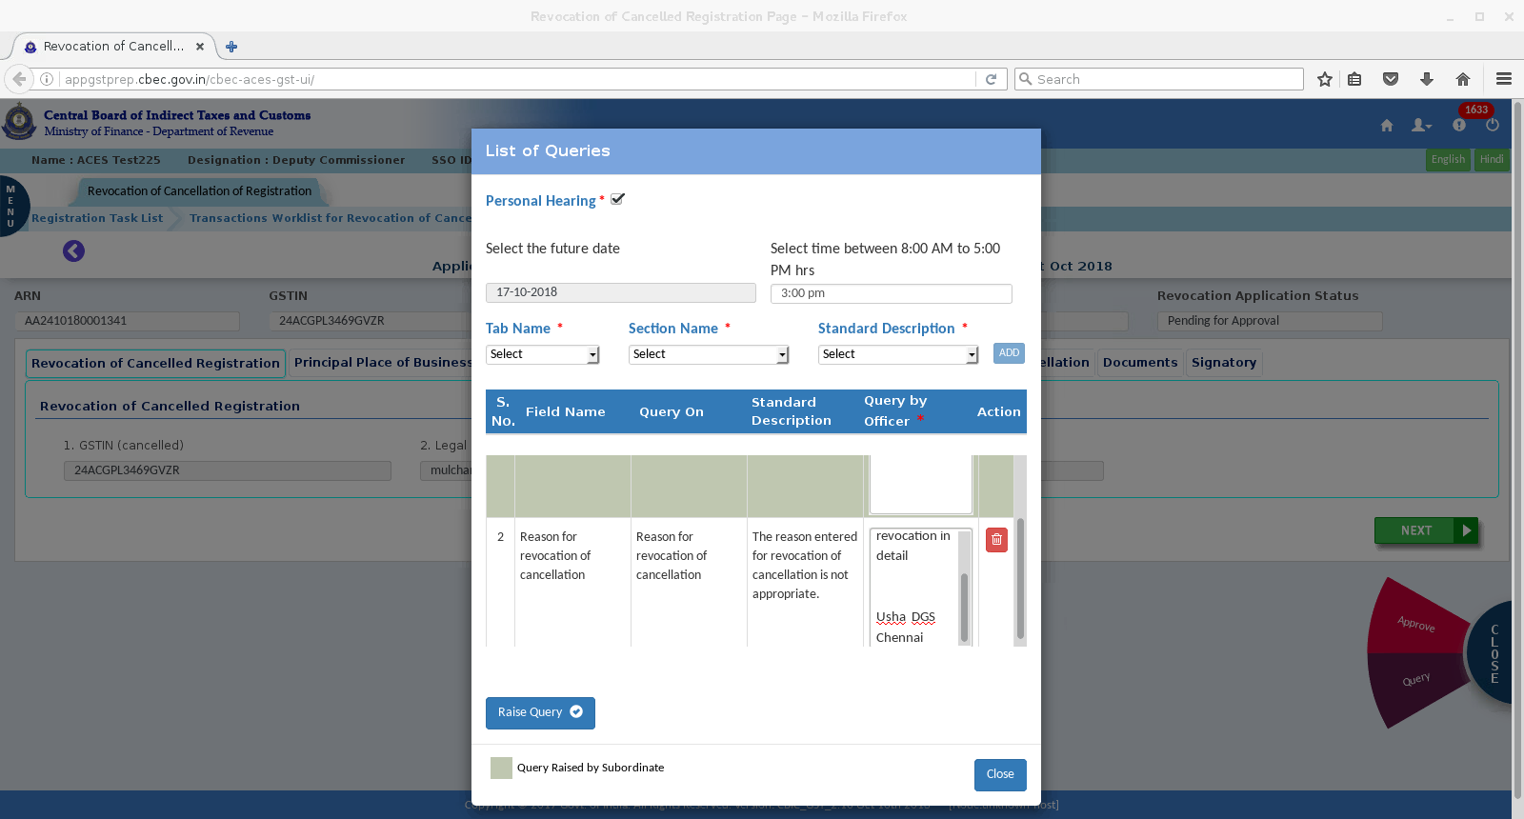
AC/DC CAN RAISE THE QUERY ON HIS OWN OR MODIFY THE QUERY RAISED BY SUPDT

Slide 24
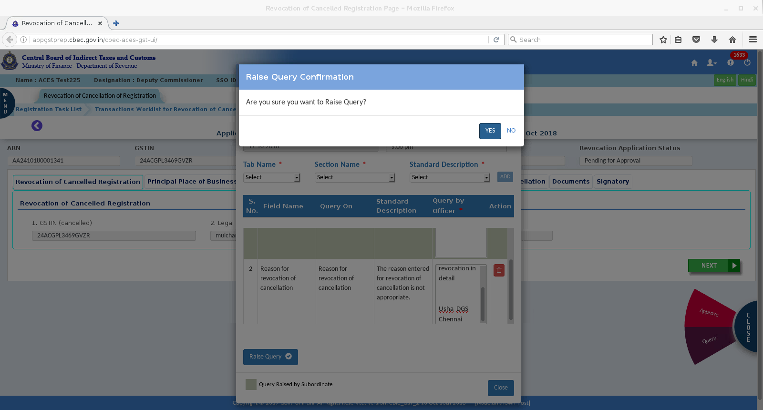
AC/DC RAISES THE QUERY SUCCESSFULLY – CONFIRMATION SCREN

Slide 25
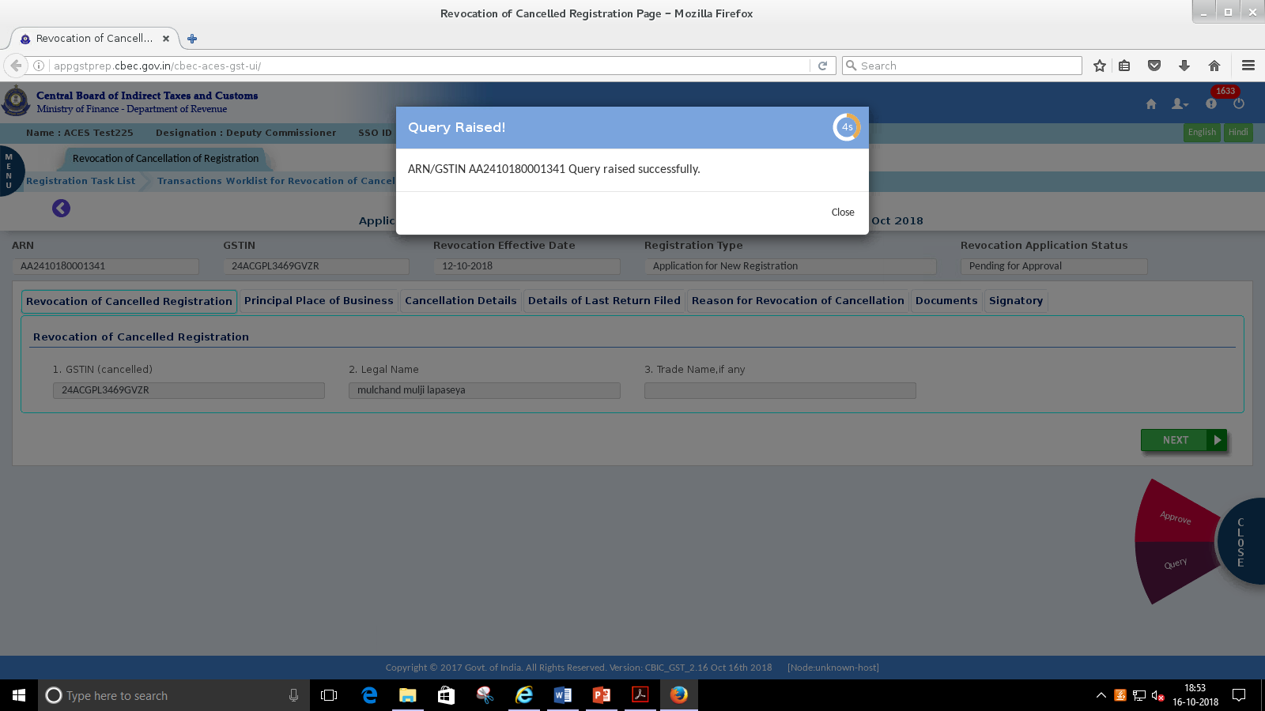

Slide 26
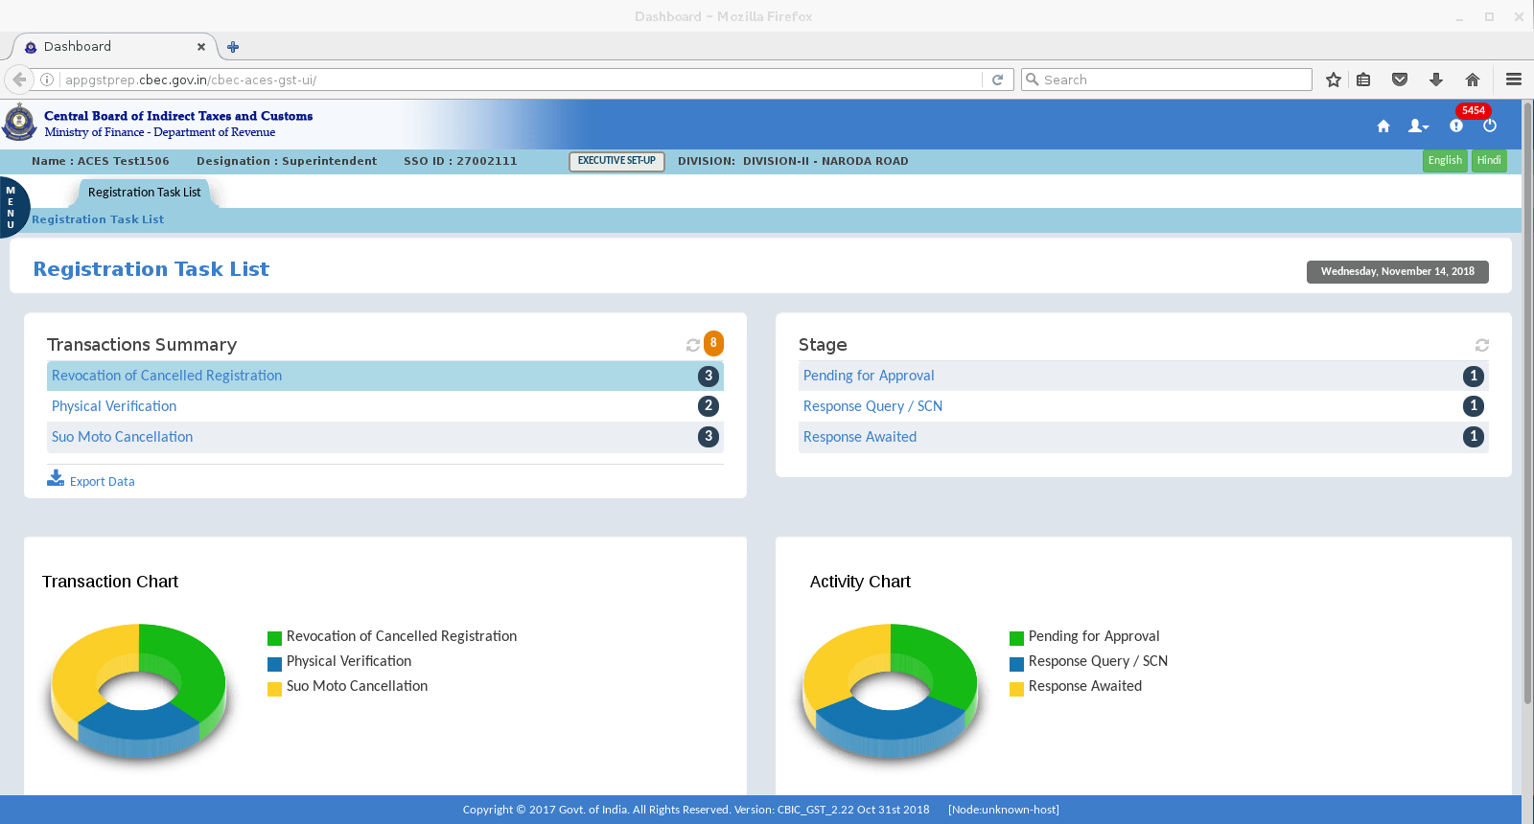
RESPONSE RECEIVED FOR THE QUERY RAISED

Slide 27
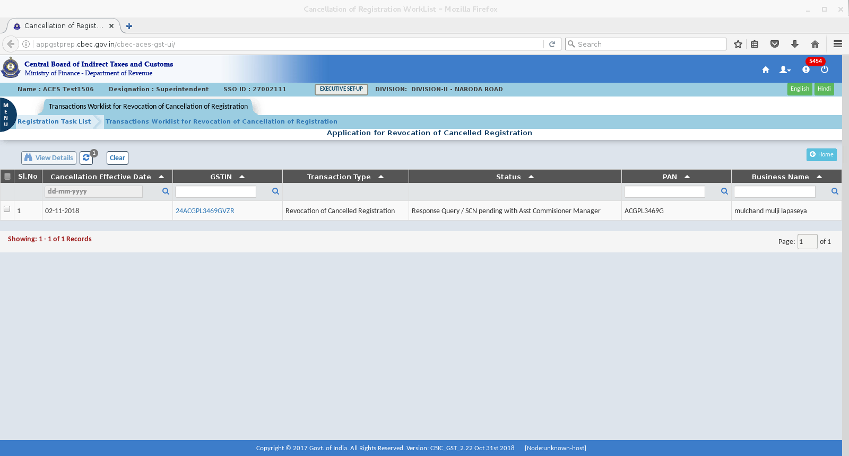
RESPONSE FROM TAXPAYER CAN BE VIEWED BY CLICKING ON THE GSTIN

Slide 28
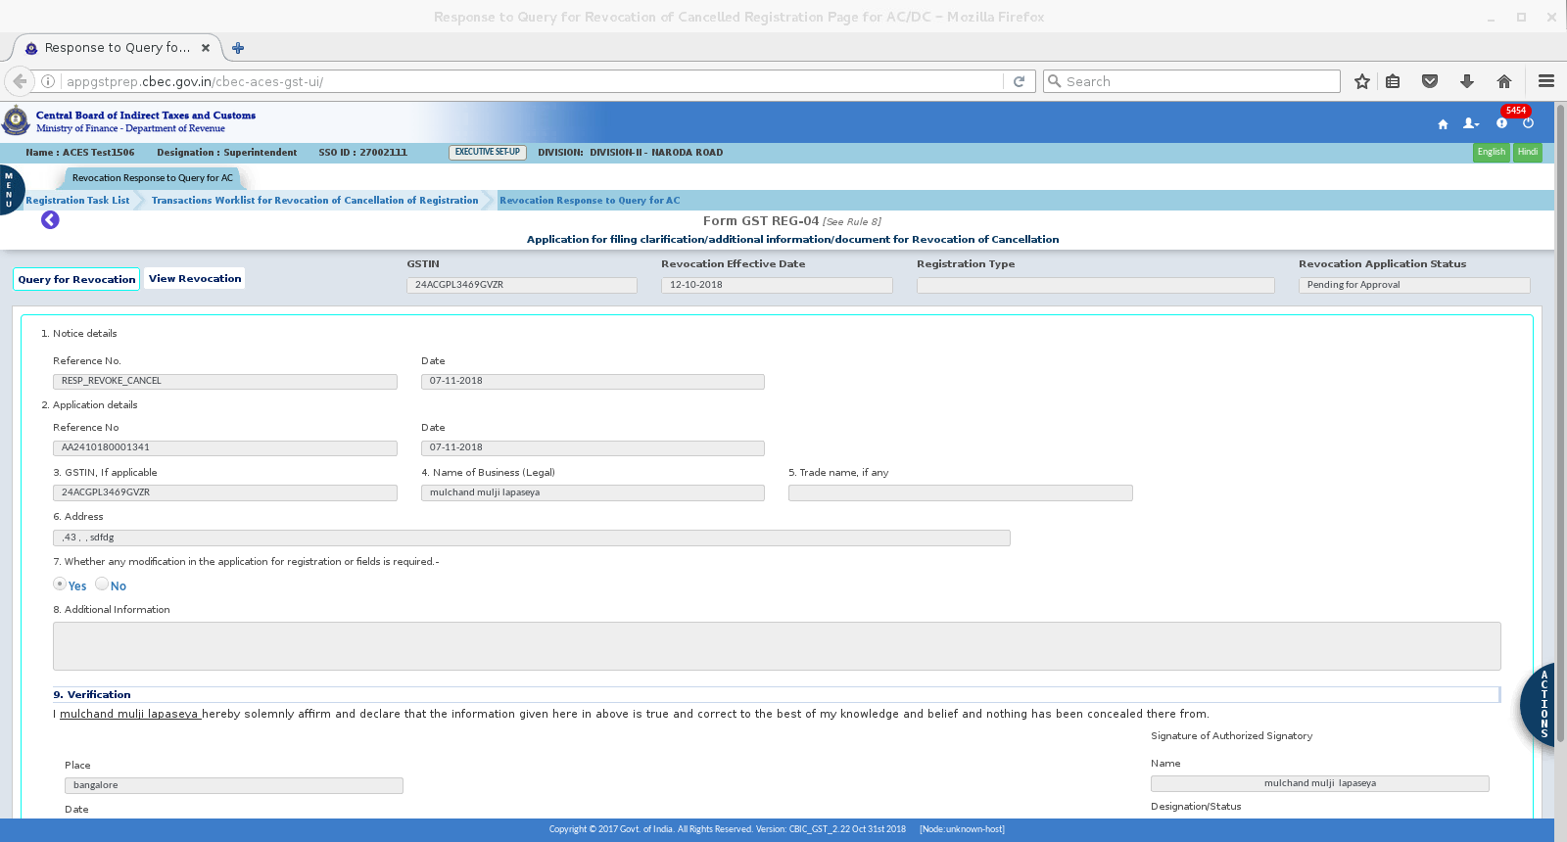

Slide 29
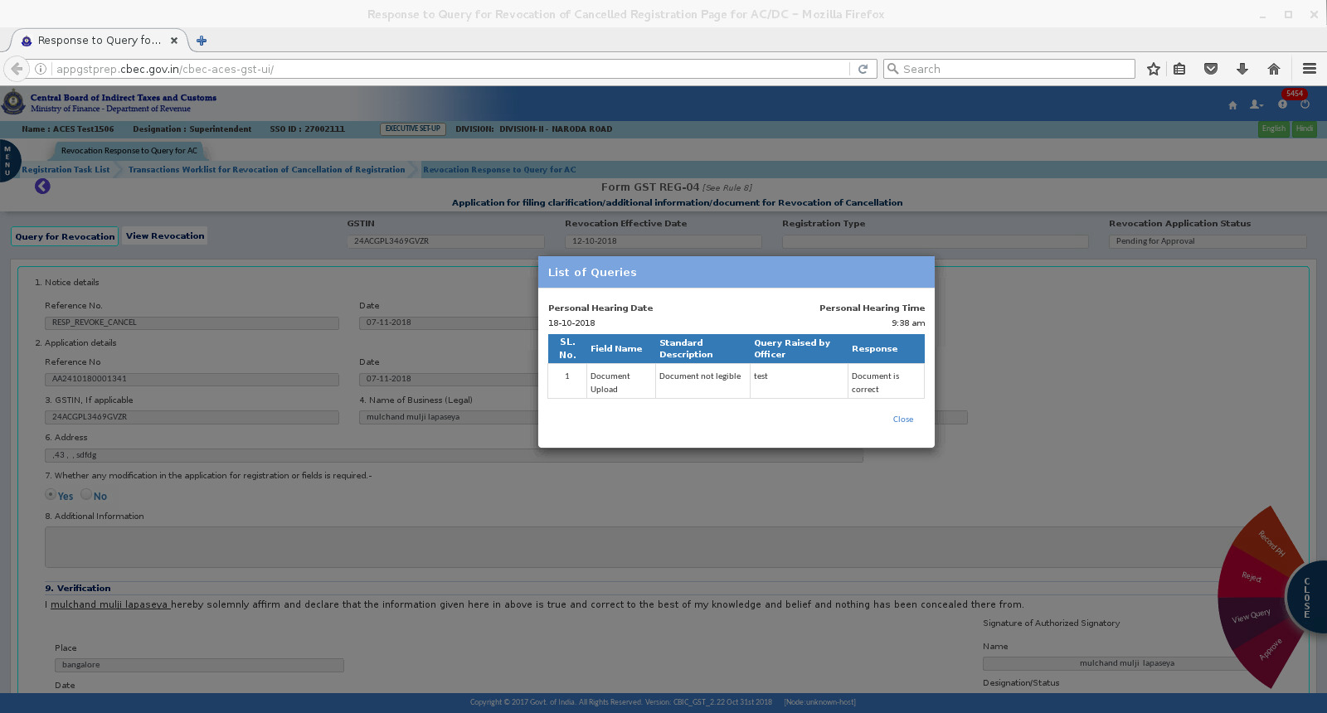
ON CLICK OF VIEW QUERY FROM ACTION BUTTON – QUERY RAISED BY OFFICER IS SEEN

Slide 30
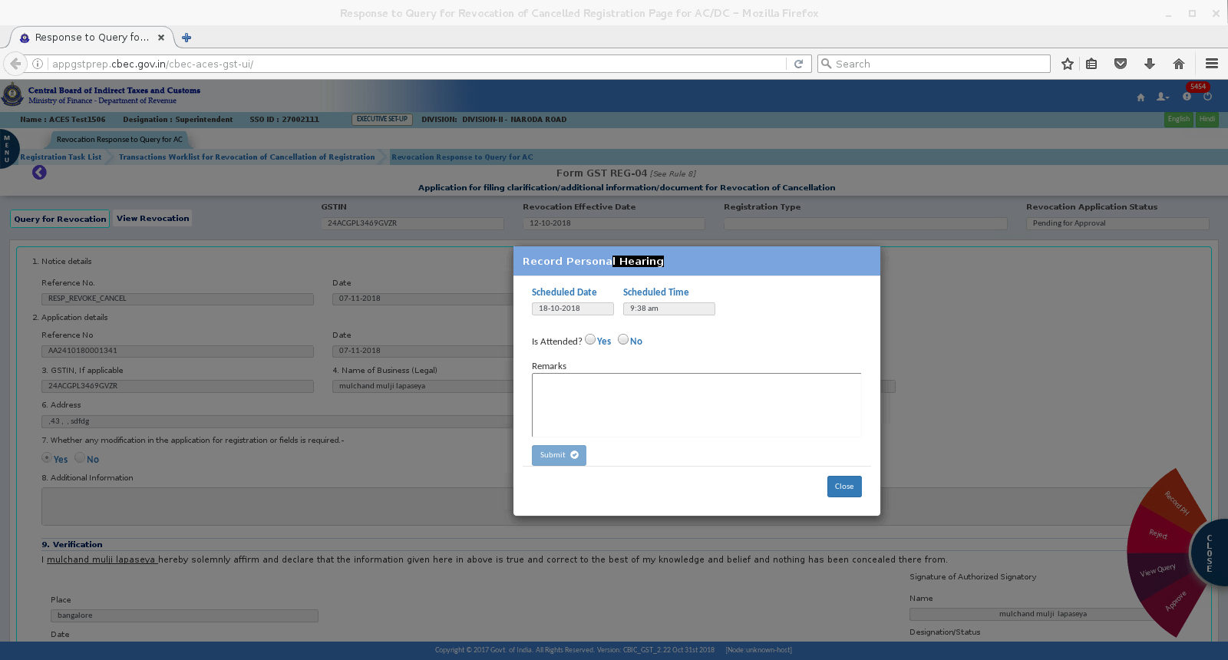
On click of Record PH from the action button, PH Message box is appearing to enter the remarks as to whether assessee has attended PH or not .

Slide 31
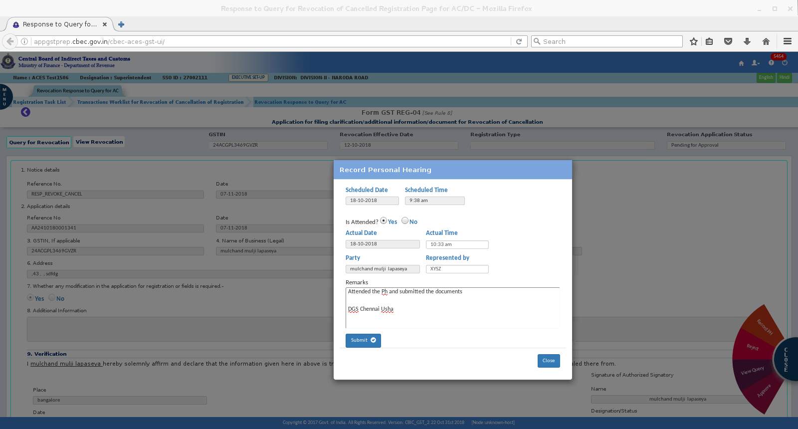
DETAILS OF PH RECORDING TO BE ENTERED

Slide 32
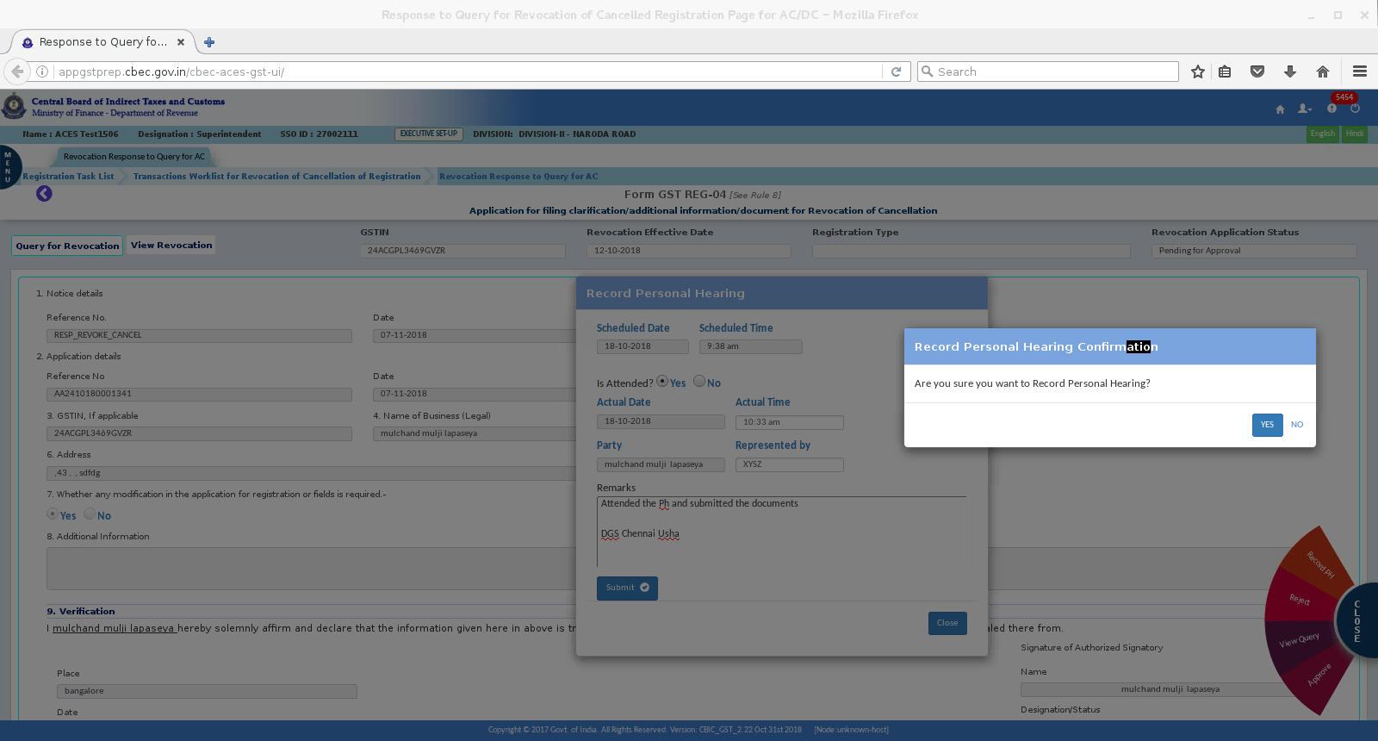
CONFIRMATION SCREEN – RECORD PH

Slide 33
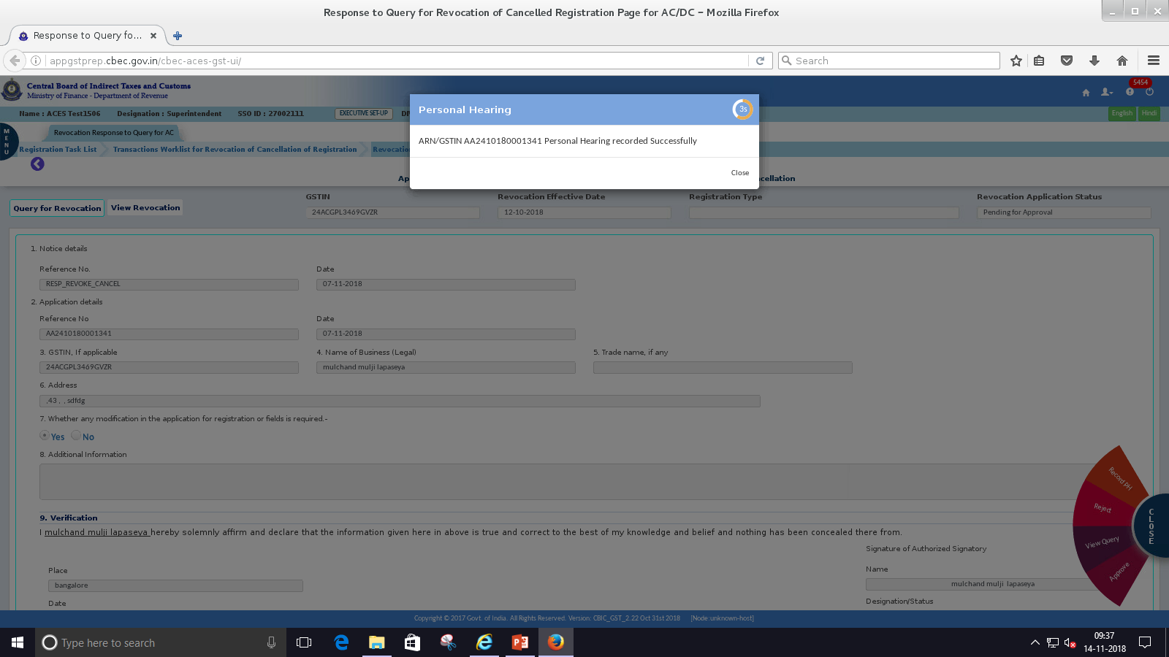

Slide 34
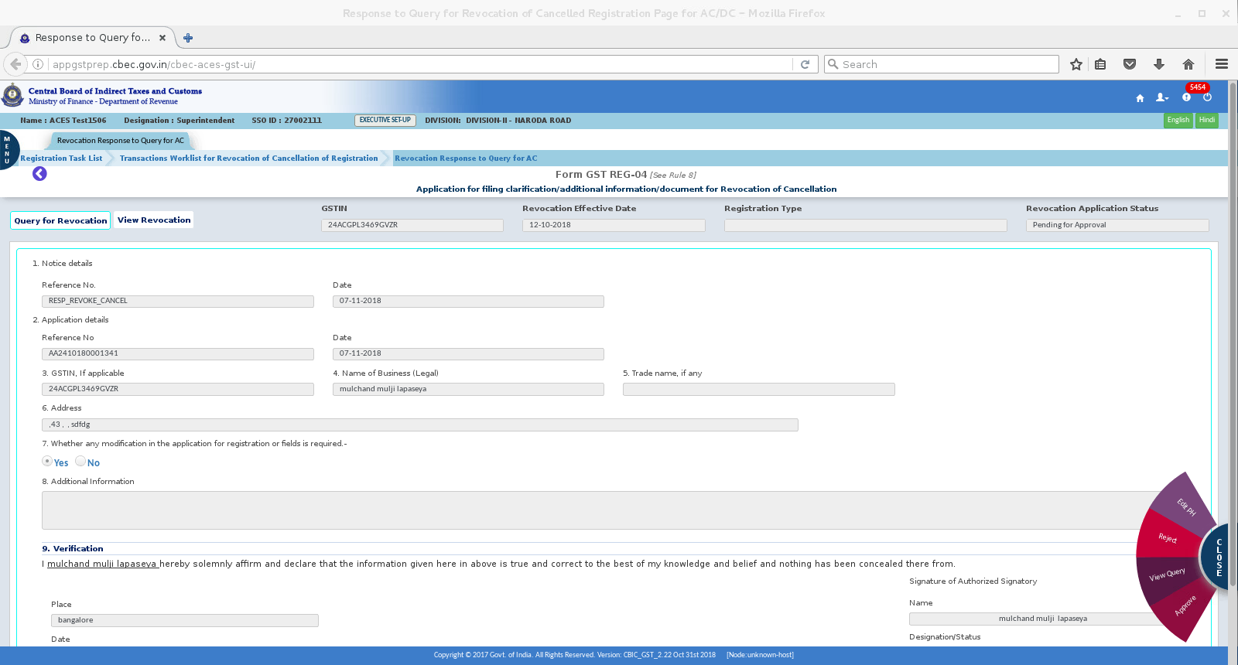
Once PH is recorded, action button will show Edit PH to be used to edit record of PH

Slide 35
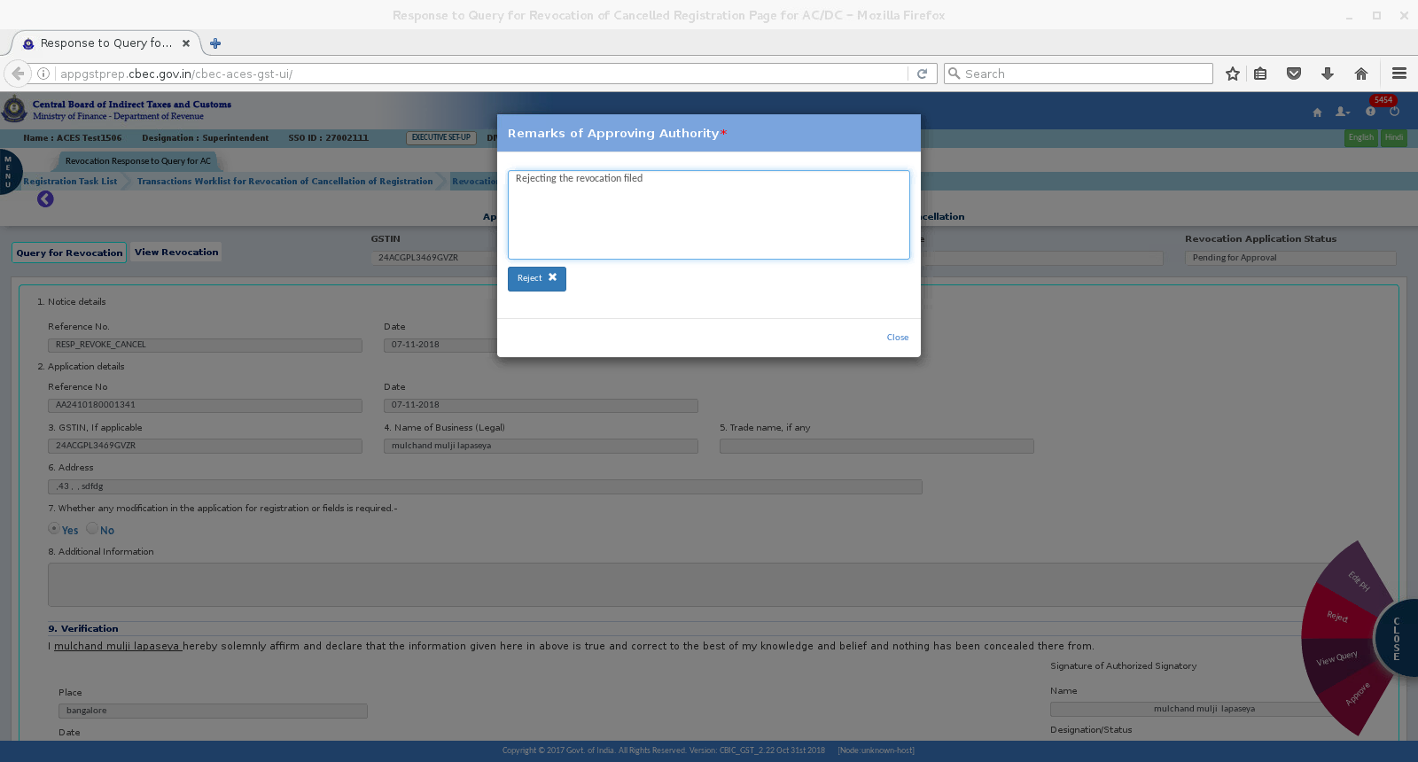
On click of Reject button screen appears as below for rejection

Slide 36
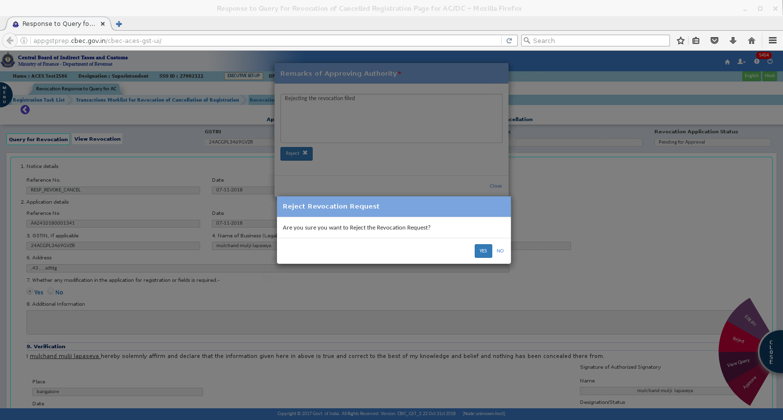
CONFRIMATION SCREEN ON REJECTION

Slide 37
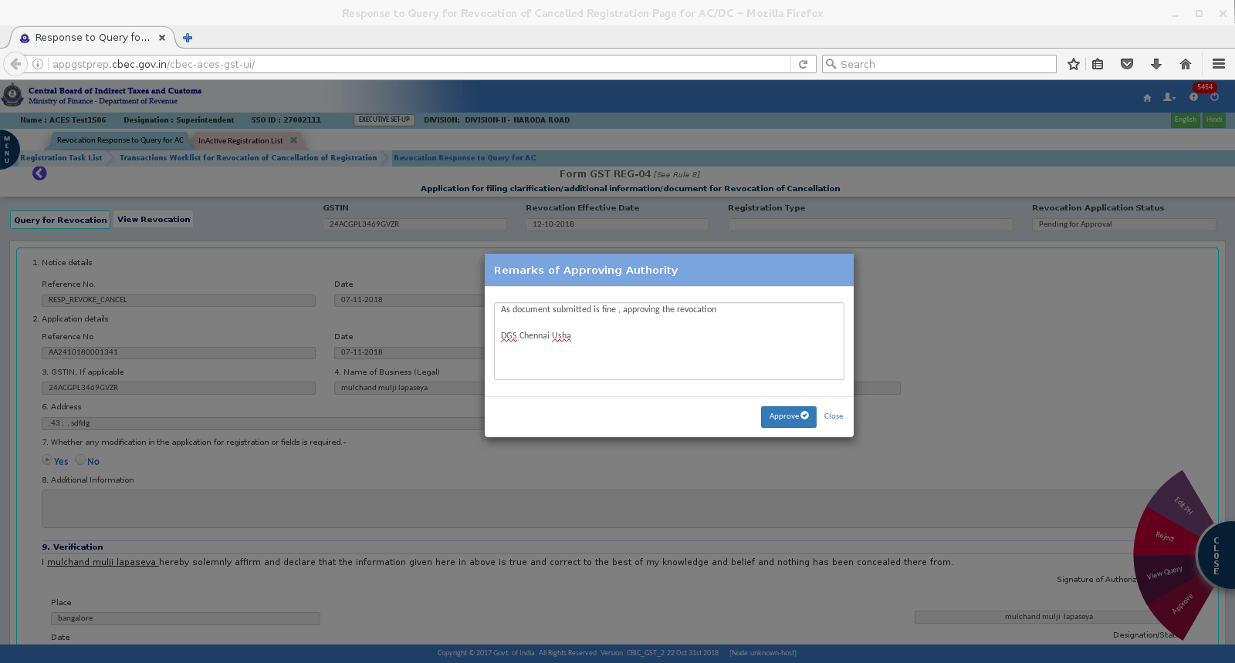
ON CLICK OF APPROVE BUTTON, MESSAGE BOX APPEARS AS BELOW WHEREIN REMARKS OF THE OFFICER TO BE ENTERED.

Slide 38
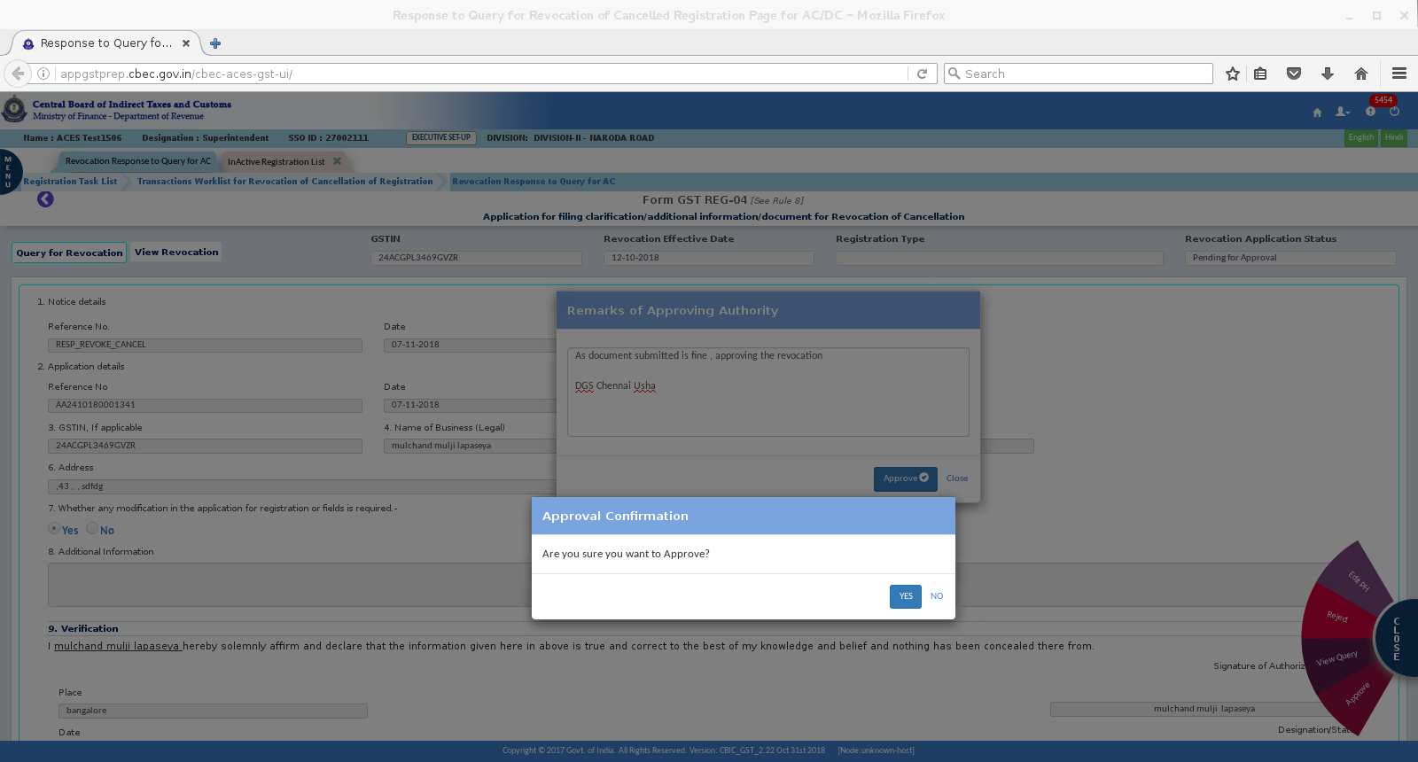
CONFIRMATION SCREEN FOR APPROVAL IS DISPLAYED

Slide 39
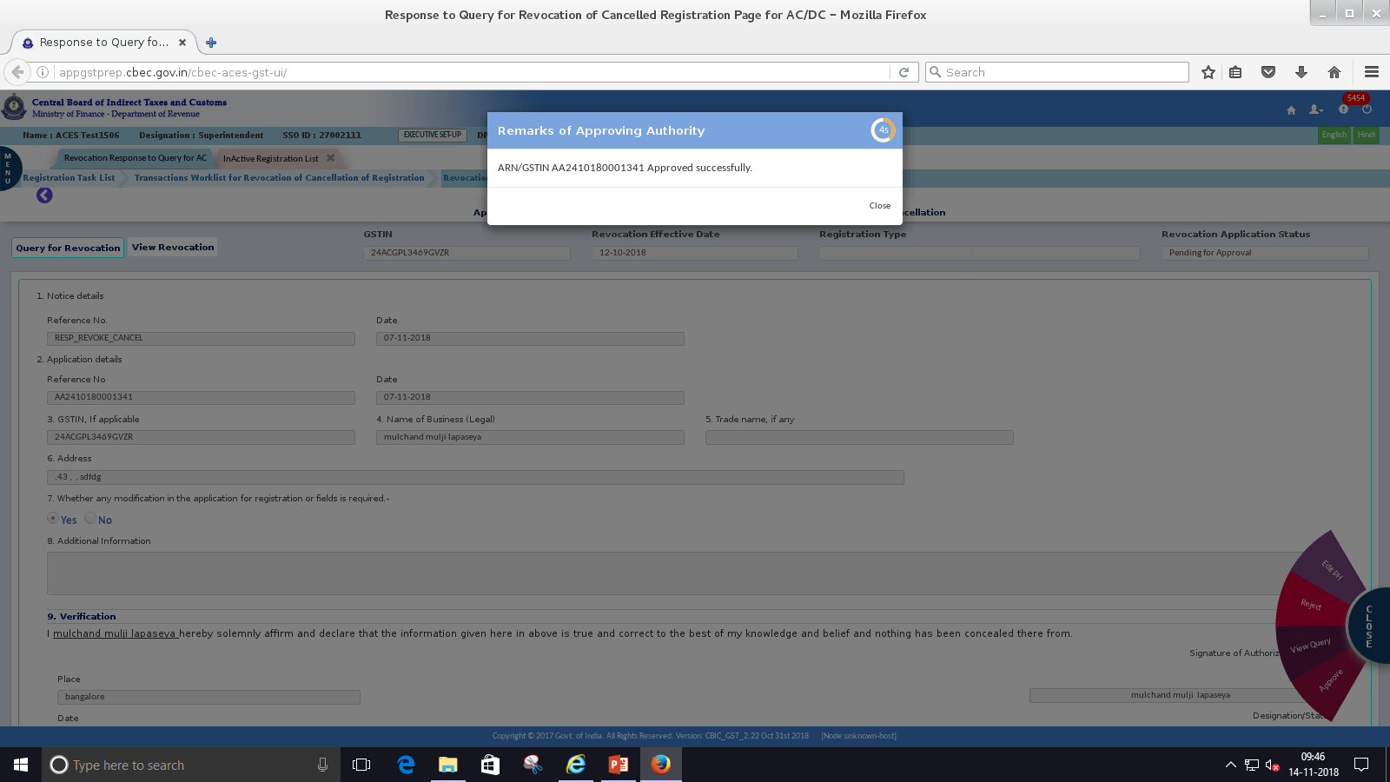

Slide 40
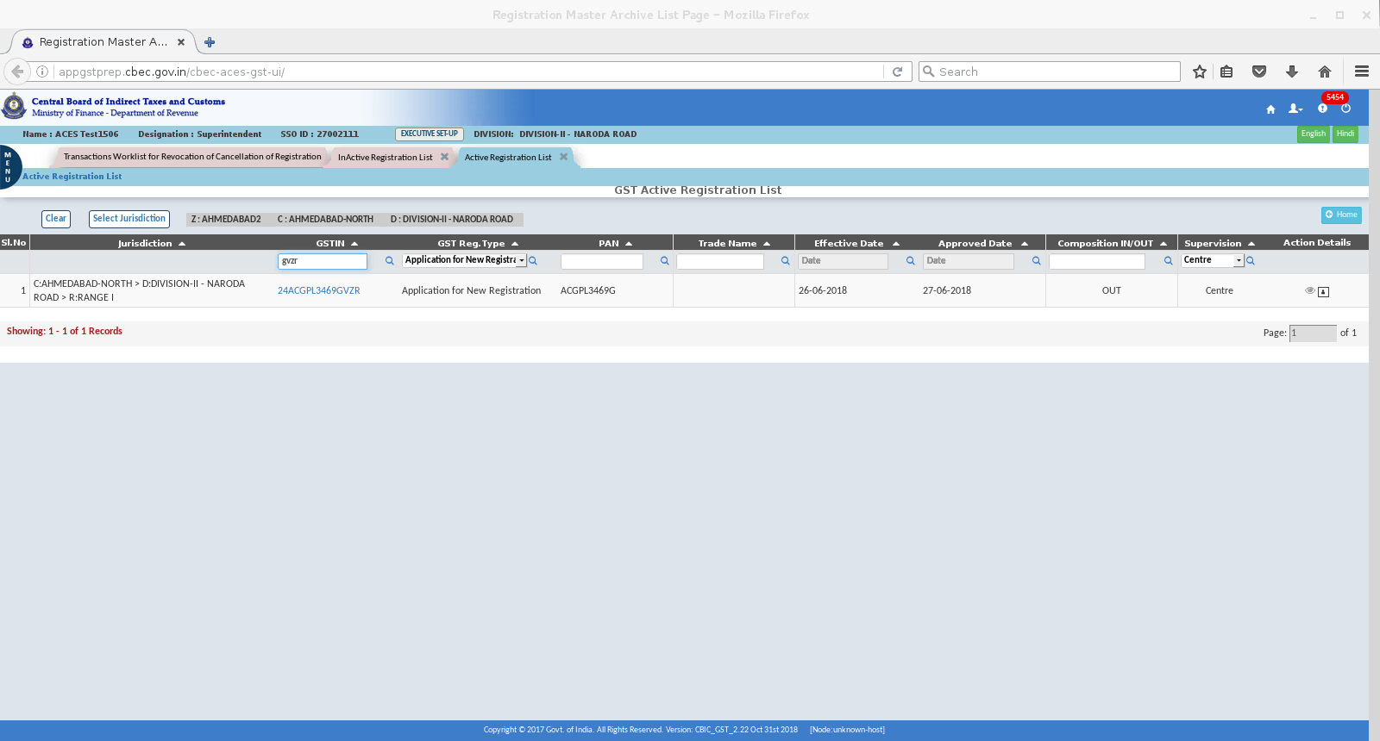
On approval of the revocation is appearing in Active Registration List.

Slide 41
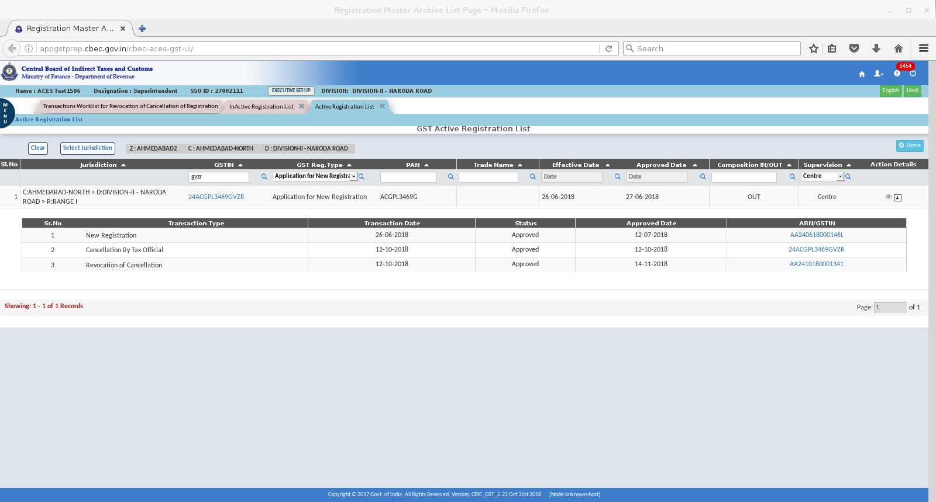
IN ACTIVE LIST – ON CLICK OF “EYE” ICON FORM ACTION DETAILS COLUMN THE DETAILS OF TRANSACTION FOR REVOCATION ARE REFLECTED.

Slide 42
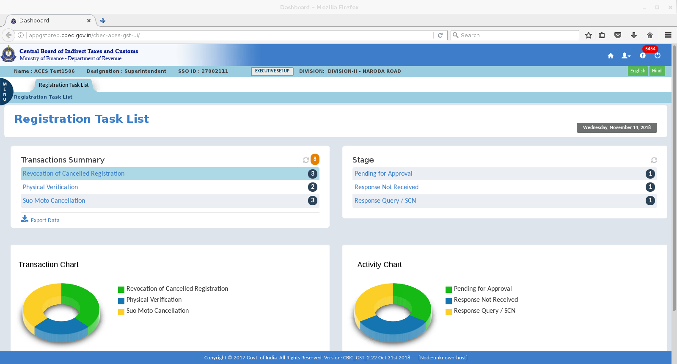
DASHBOARD SHOWS – RESPONSE NOT RECEIVED CATEGORY

Slide 43
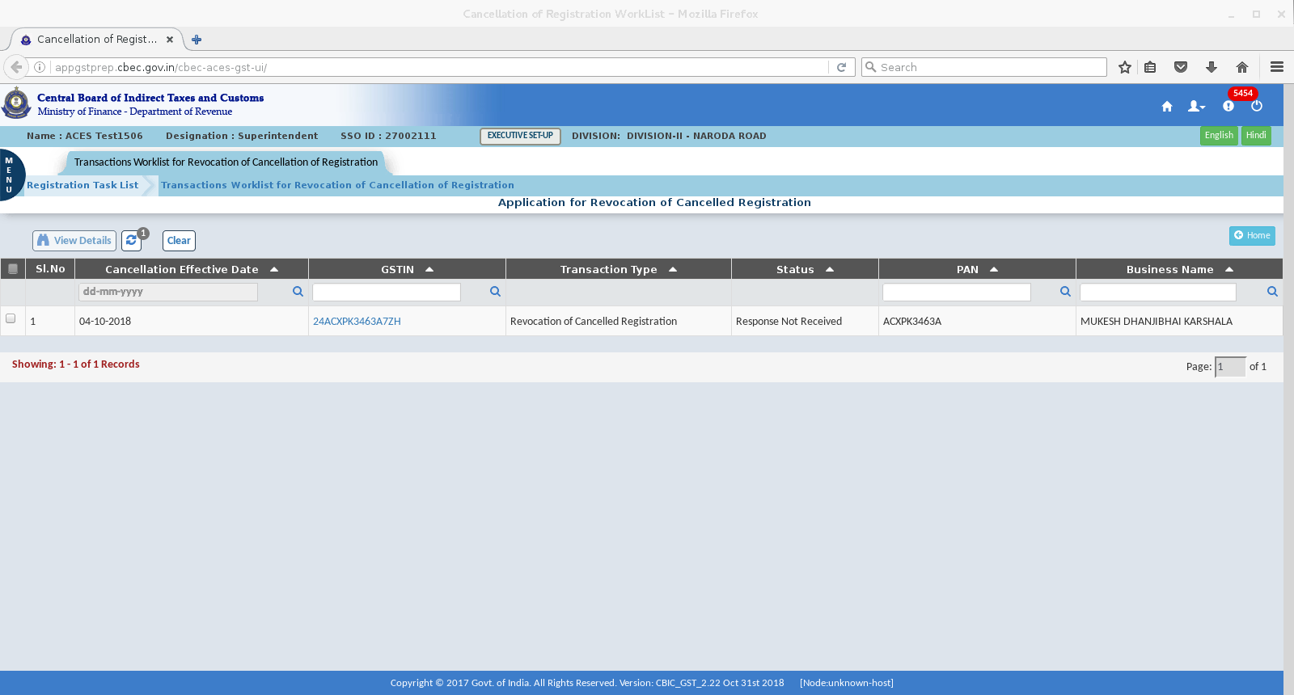

Slide 45
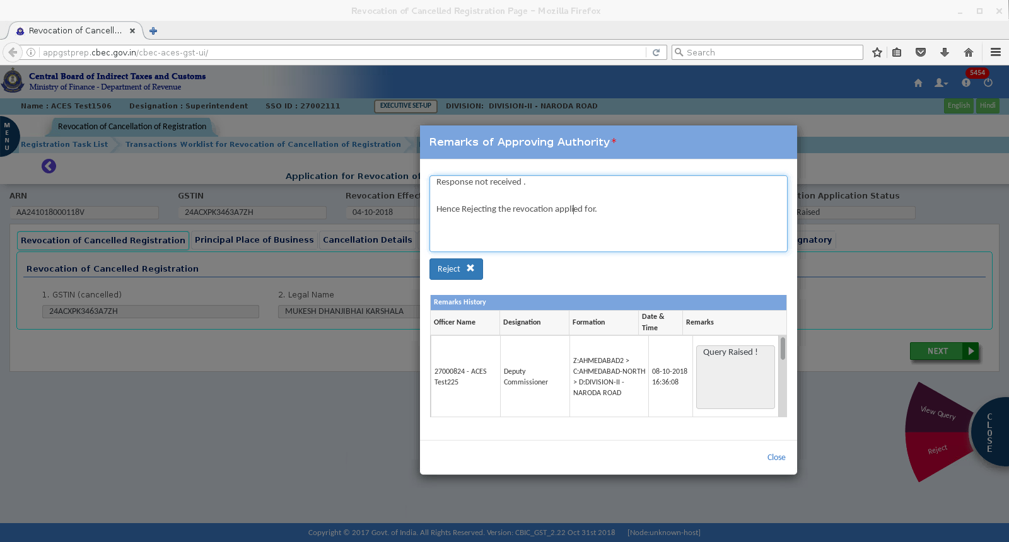
SINCE RESPONSE HAS NOT COME, THERE WILL BE OPTION ONLY TO REJECT. ON CLICK OF REJECT BUTTON – REMARKS OF THE OFFICER IS ENTERED AND REJECTED.

Slide 46
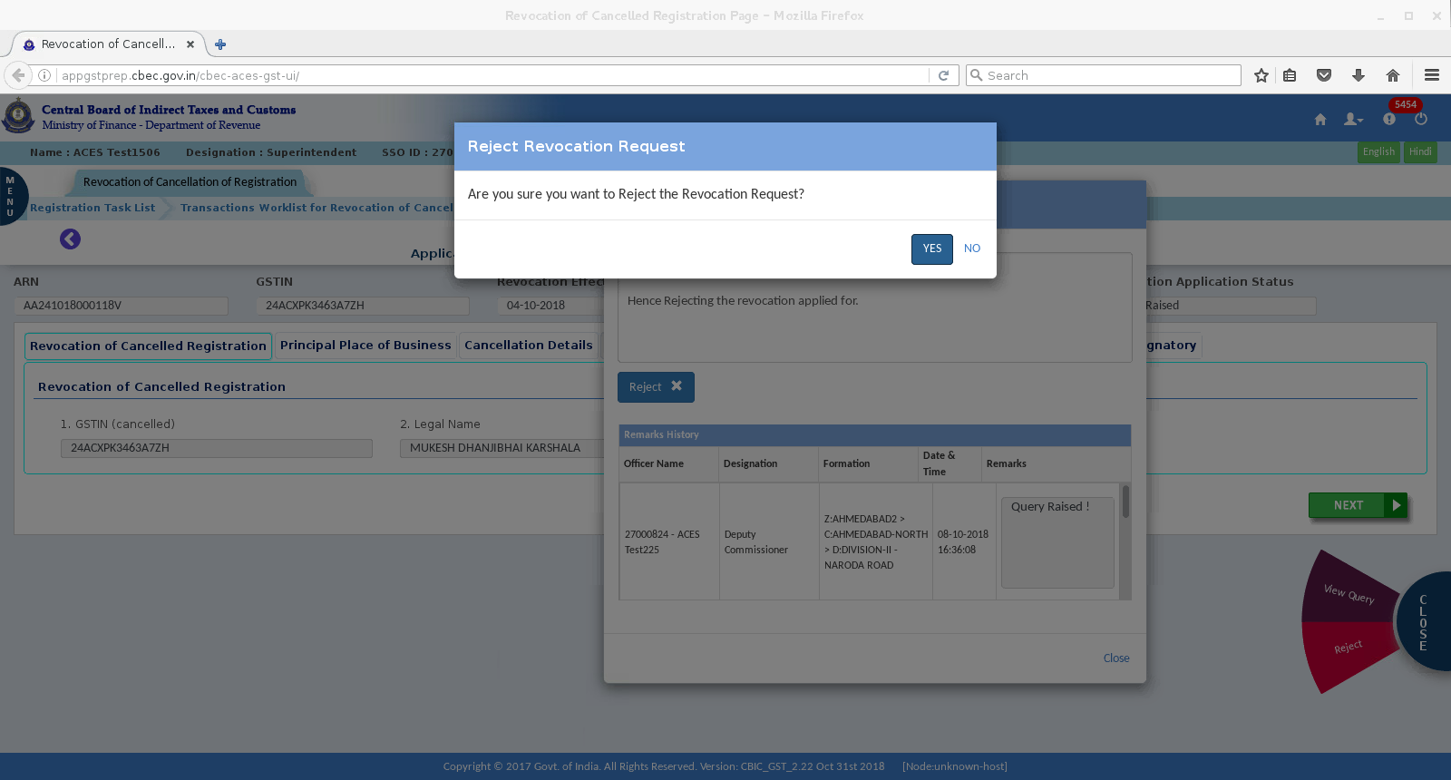

Slide 47
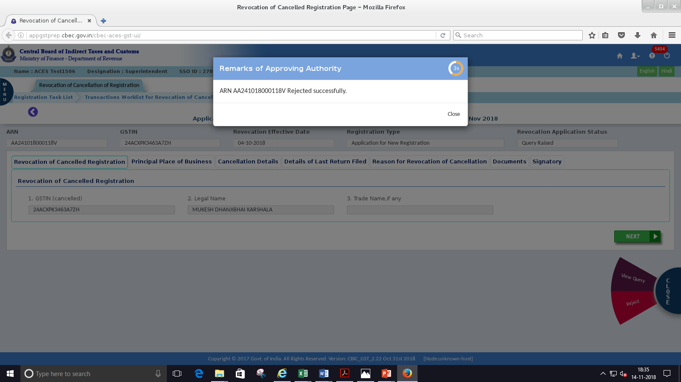

Slide 48
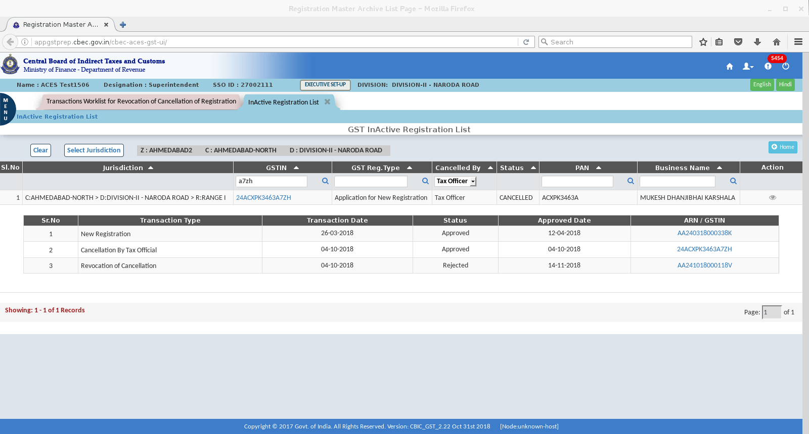
On rejecting the cancellation – GSTIN remains in inactive list

